Slide 1
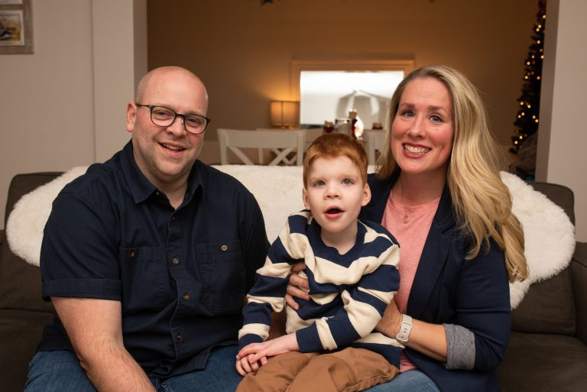






Naming the Needs
and identifying resources
Chrissy Salley, Ph.D.
Director of Clinician Engagement & Outreach
www.courageousparentsnetwork.org
@courageousparentsnetwork
Notes:
You have to name it to tame it – and to address it and support it

Slide 2





Courageous Parents Network Initiatives
Navigating Medical Complexity
NeuroJourney
Coping With Loss
neurojourney.org
copingwithloss.org
medicalcomplexity.org
Presents many medical, social and emotional aspects of the Severe Neurological Impairment (SNI) disease trajectory in four phases, to inform and support caregivers anticipating the challenges and preparing for difficult decisions that may lie ahead.
Offers parent insights, and family and clinician descriptions of the grief experience, to assure families that they can carry on and even thrive as they try to survive the most painful and lasting grief of all—the death of a beloved child.
Includes content originally created for CourageousParentsNetwork.org. Three phases of the journey orient and guide caregivers of a child with a serious medical condition, bringing a sense of what they may experience regardless of diagnosis or prognosis.
@courageousparentsnetwork
www.courageousparentsnetwork.org

Slide 3
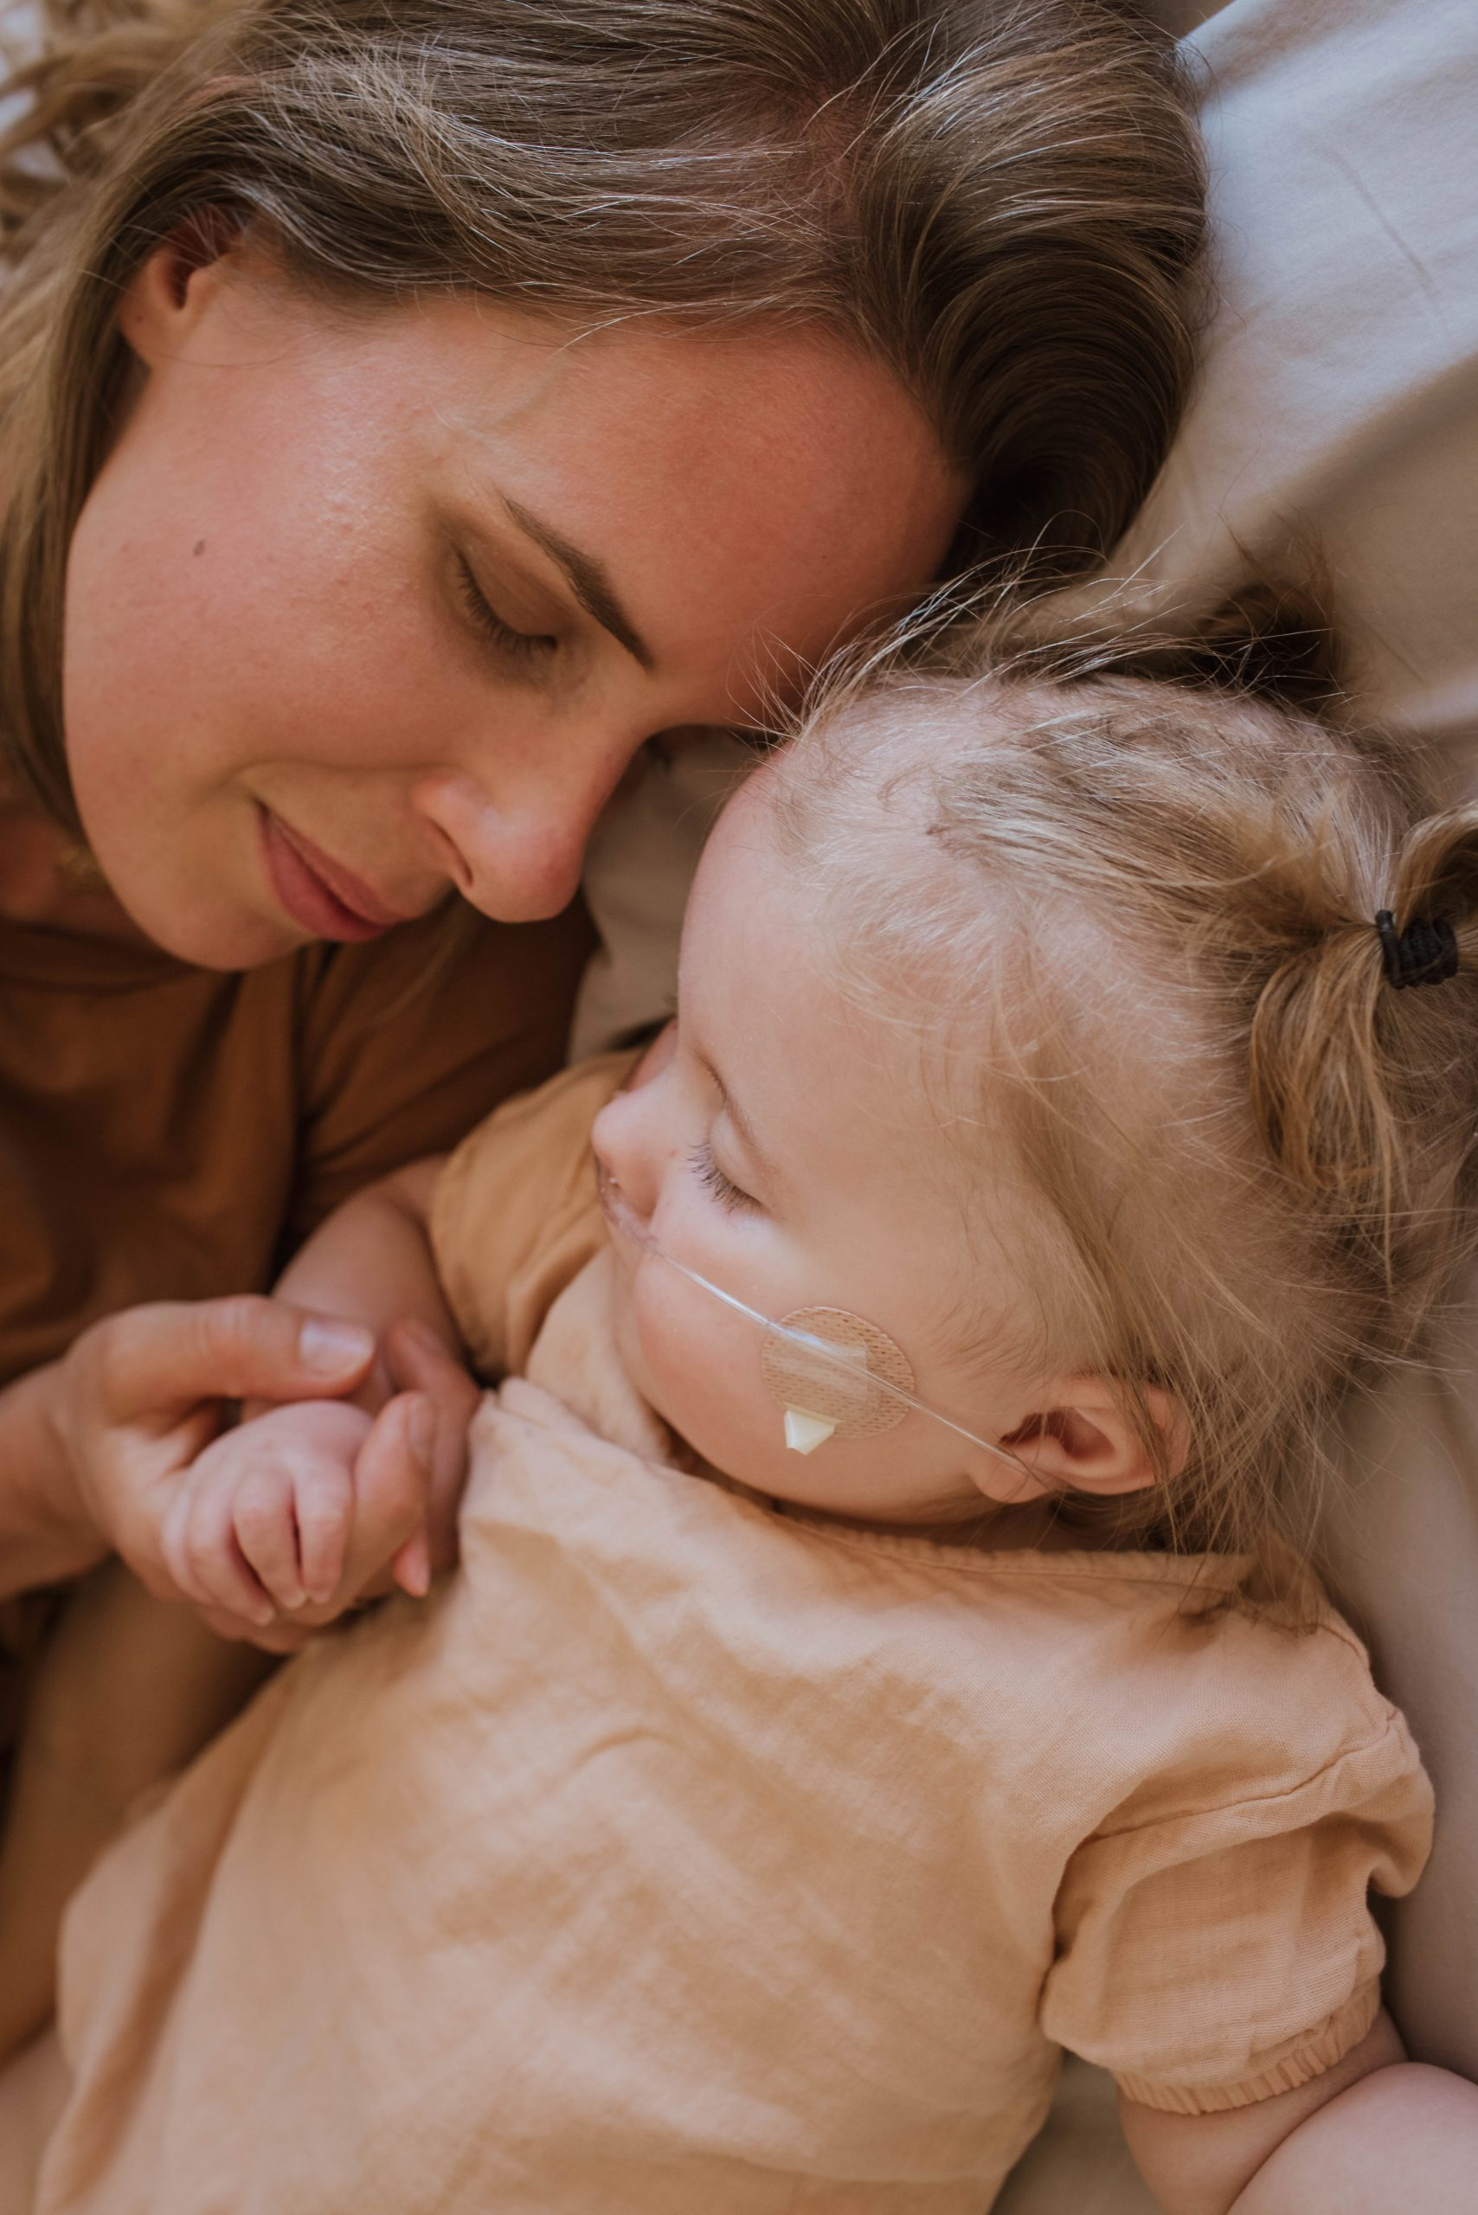


Looking back at those first few weeks and months, I remember the anger and despair, the uncertainty and grief. There were so many questions, with very few answers; What was the best-case scenario? Or the worst-case? What did this mean for our family? And more, I wondered and worried; Could I have done anything to cause my daughter’s differences?
Karen, Leia’s mom
www.courageousparentsnetwork.org
@courageousparentsnetwork

Slide 4
Anticipatory Guidance
Looking ahead
Accurate information
Short-, intermediate-, long-term
Delivered honestly and with compassion
@courageousparentsnetwork
www.courageousparentsnetwork.org
Notes:
Anticipatory guidance is delivered by pediatricians, but what does it look like for families of children with medical complexity.

Slide 5
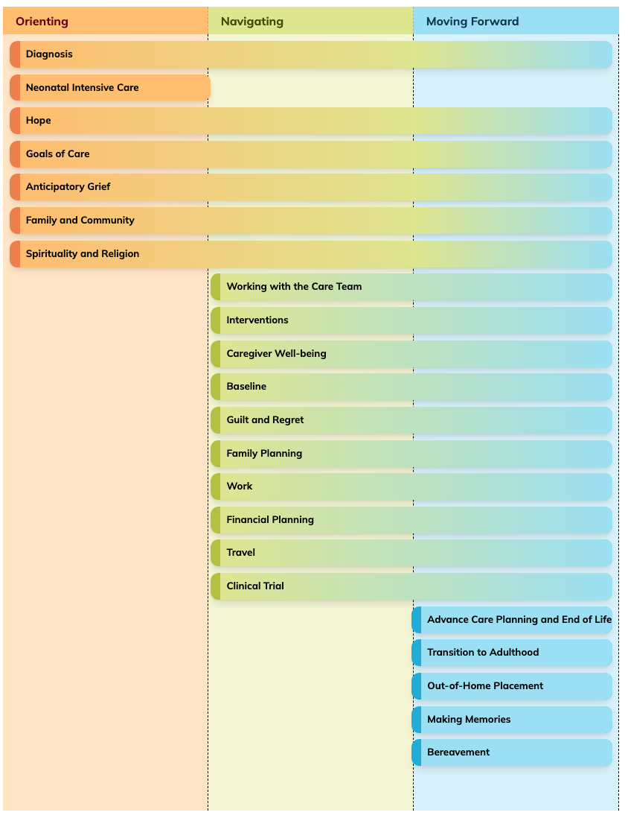
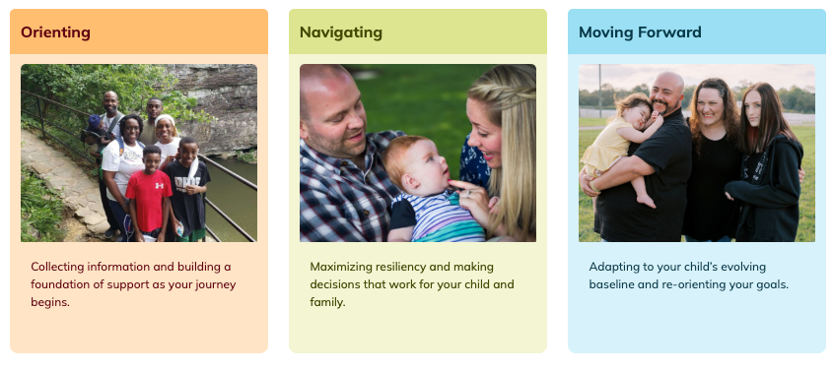
Navigating
Medical
Complexity
@courageousparentsnetwork
www.courageousparentsnetwork.org
Notes:
VIDEO TEMPLATE
Click ‘insert’ in the top left corner
Click the dropdown associated with ‘Video’ on the right end of the tool bar
If using a video from the web, select Online Movie’ and enter your desired URL
If using a video from your computer, select ‘Movie from file’ to browse videos being held on your device
Once the video is on the page you can manipulate it’s size until everything works at it’s best.

Slide 6
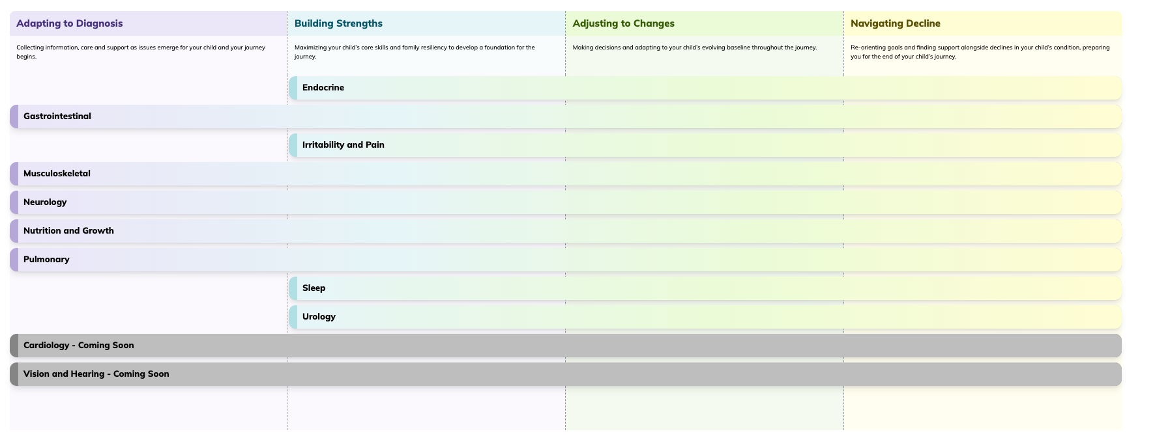
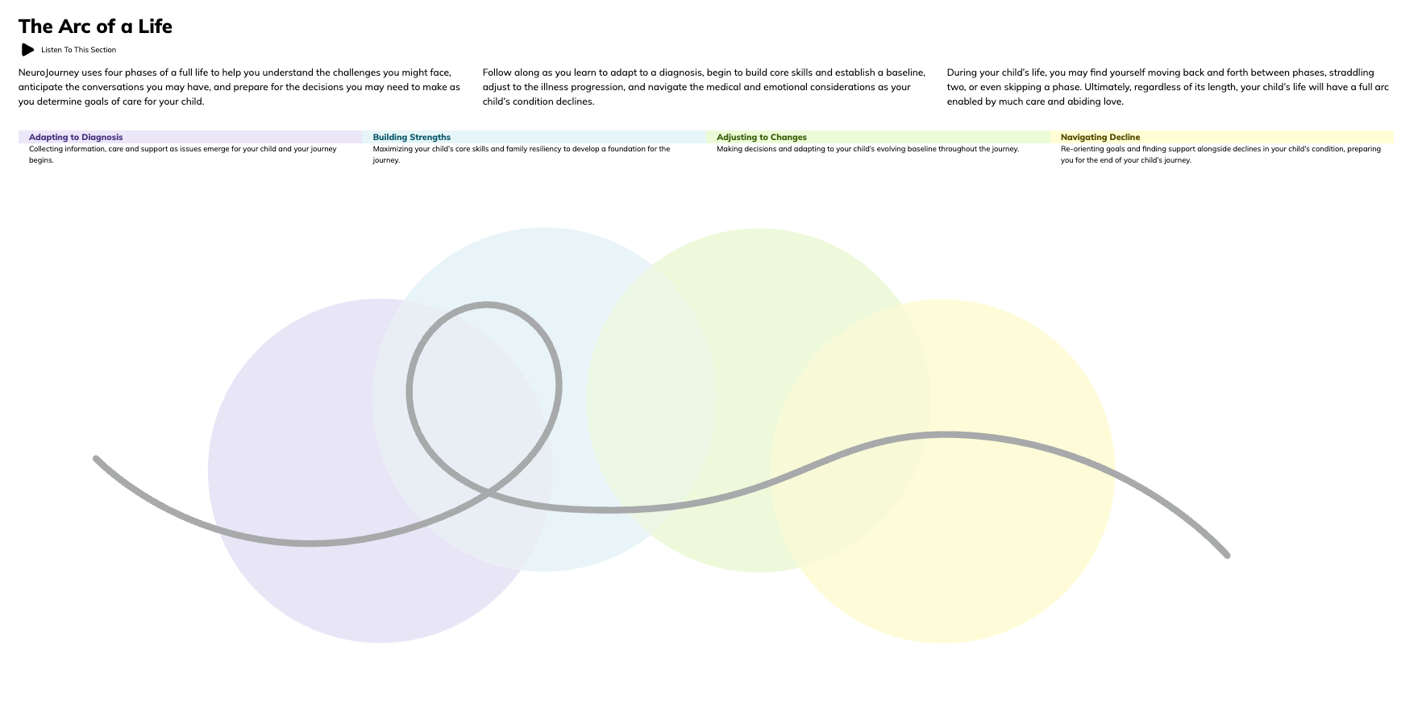
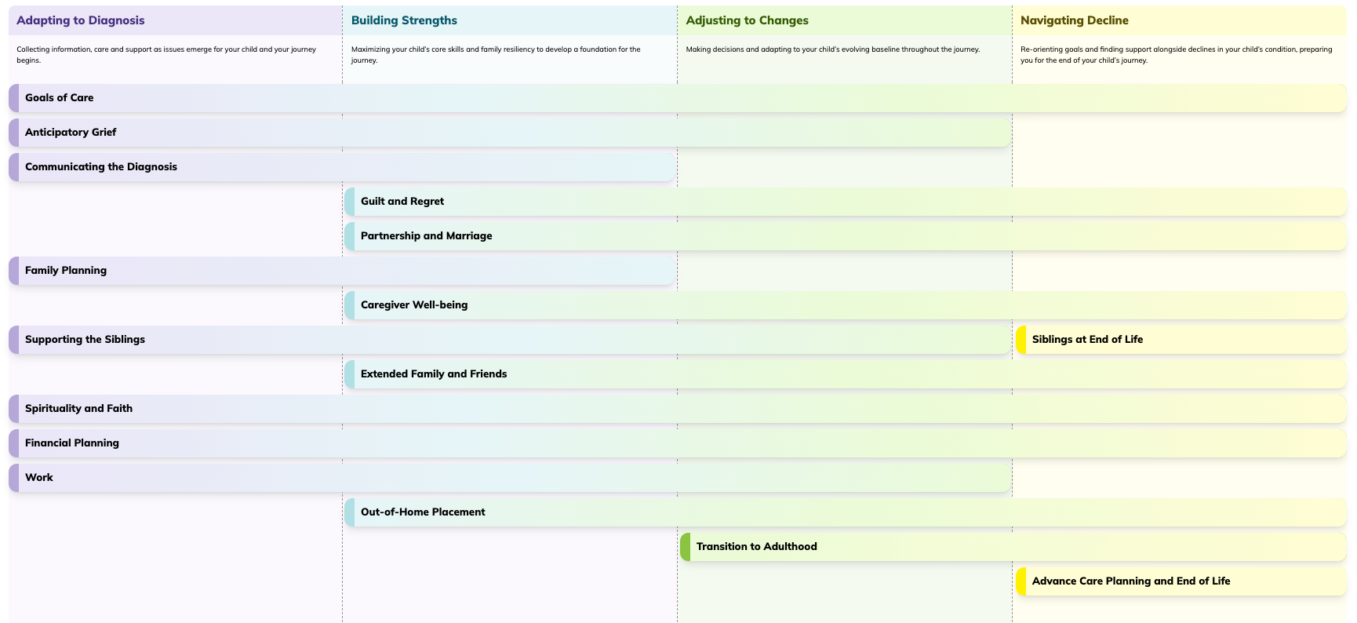
NeuroJourney
@courageousparentsnetwork
www.courageousparentsnetwork.org
Notes:
VIDEO TEMPLATE
Click ‘insert’ in the top left corner
Click the dropdown associated with ‘Video’ on the right end of the tool bar
If using a video from the web, select Online Movie’ and enter your desired URL
If using a video from your computer, select ‘Movie from file’ to browse videos being held on your device
Once the video is on the page you can manipulate it’s size until everything works at it’s best.

Slide 7
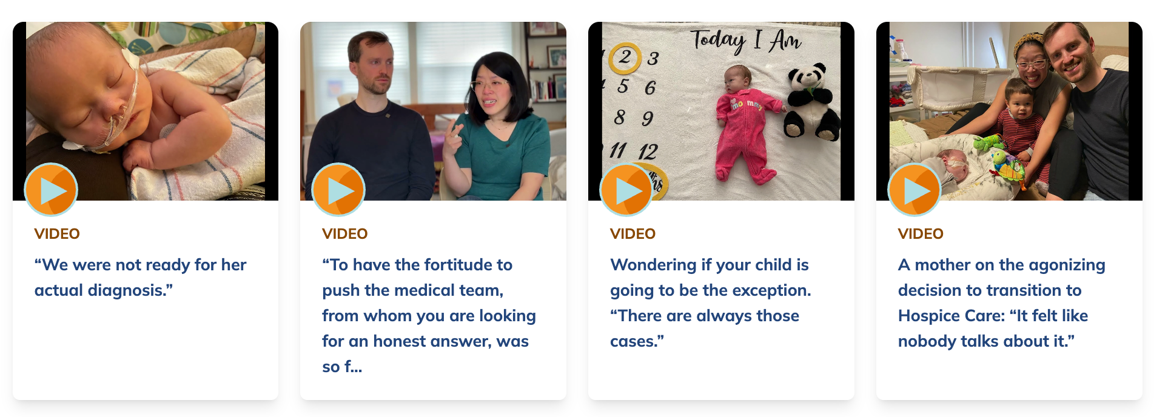
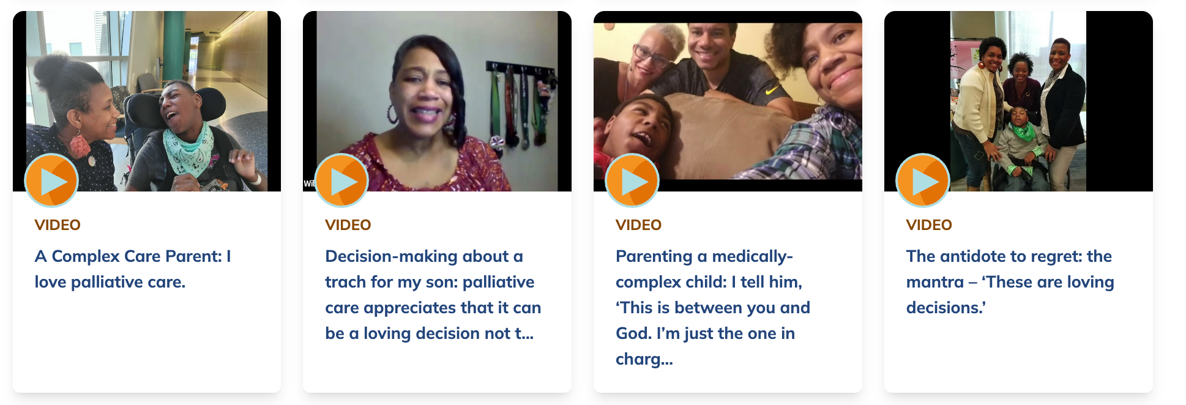
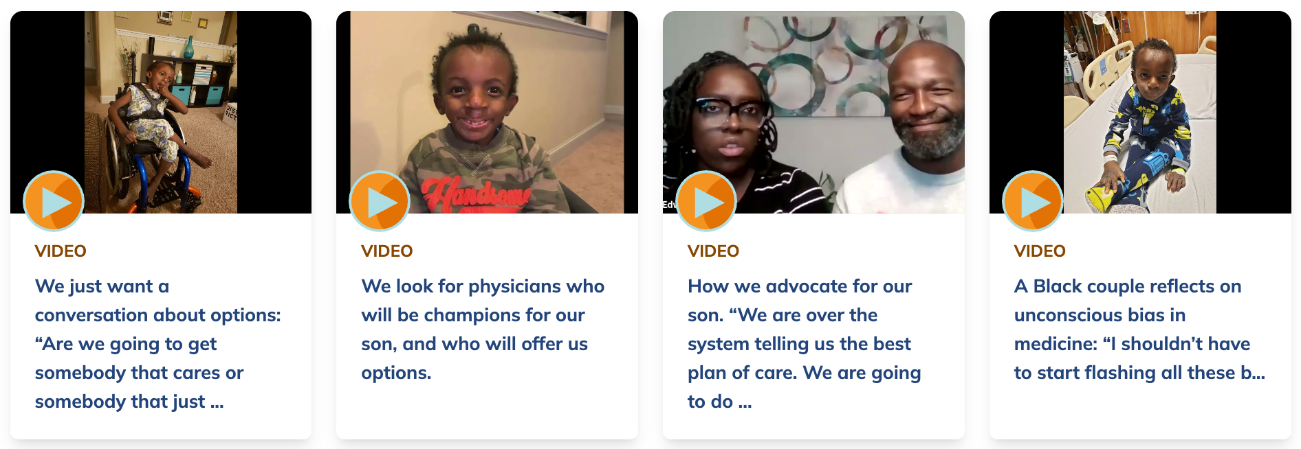
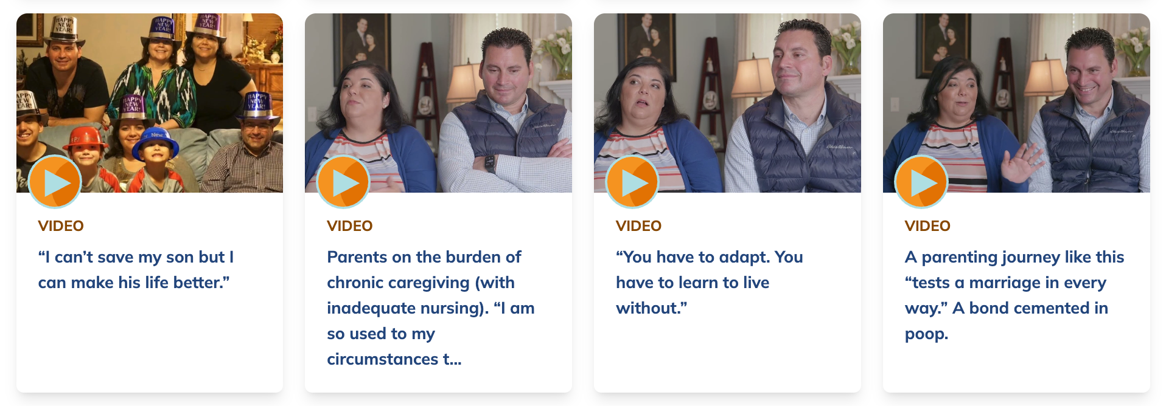
Perspectives from Others
@courageousparentsnetwork
www.courageousparentsnetwork.org
Notes:
VIDEO TEMPLATE
Click ‘insert’ in the top left corner
Click the dropdown associated with ‘Video’ on the right end of the tool bar
If using a video from the web, select Online Movie’ and enter your desired URL
If using a video from your computer, select ‘Movie from file’ to browse videos being held on your device
Once the video is on the page you can manipulate it’s size until everything works at it’s best.

Slide 8
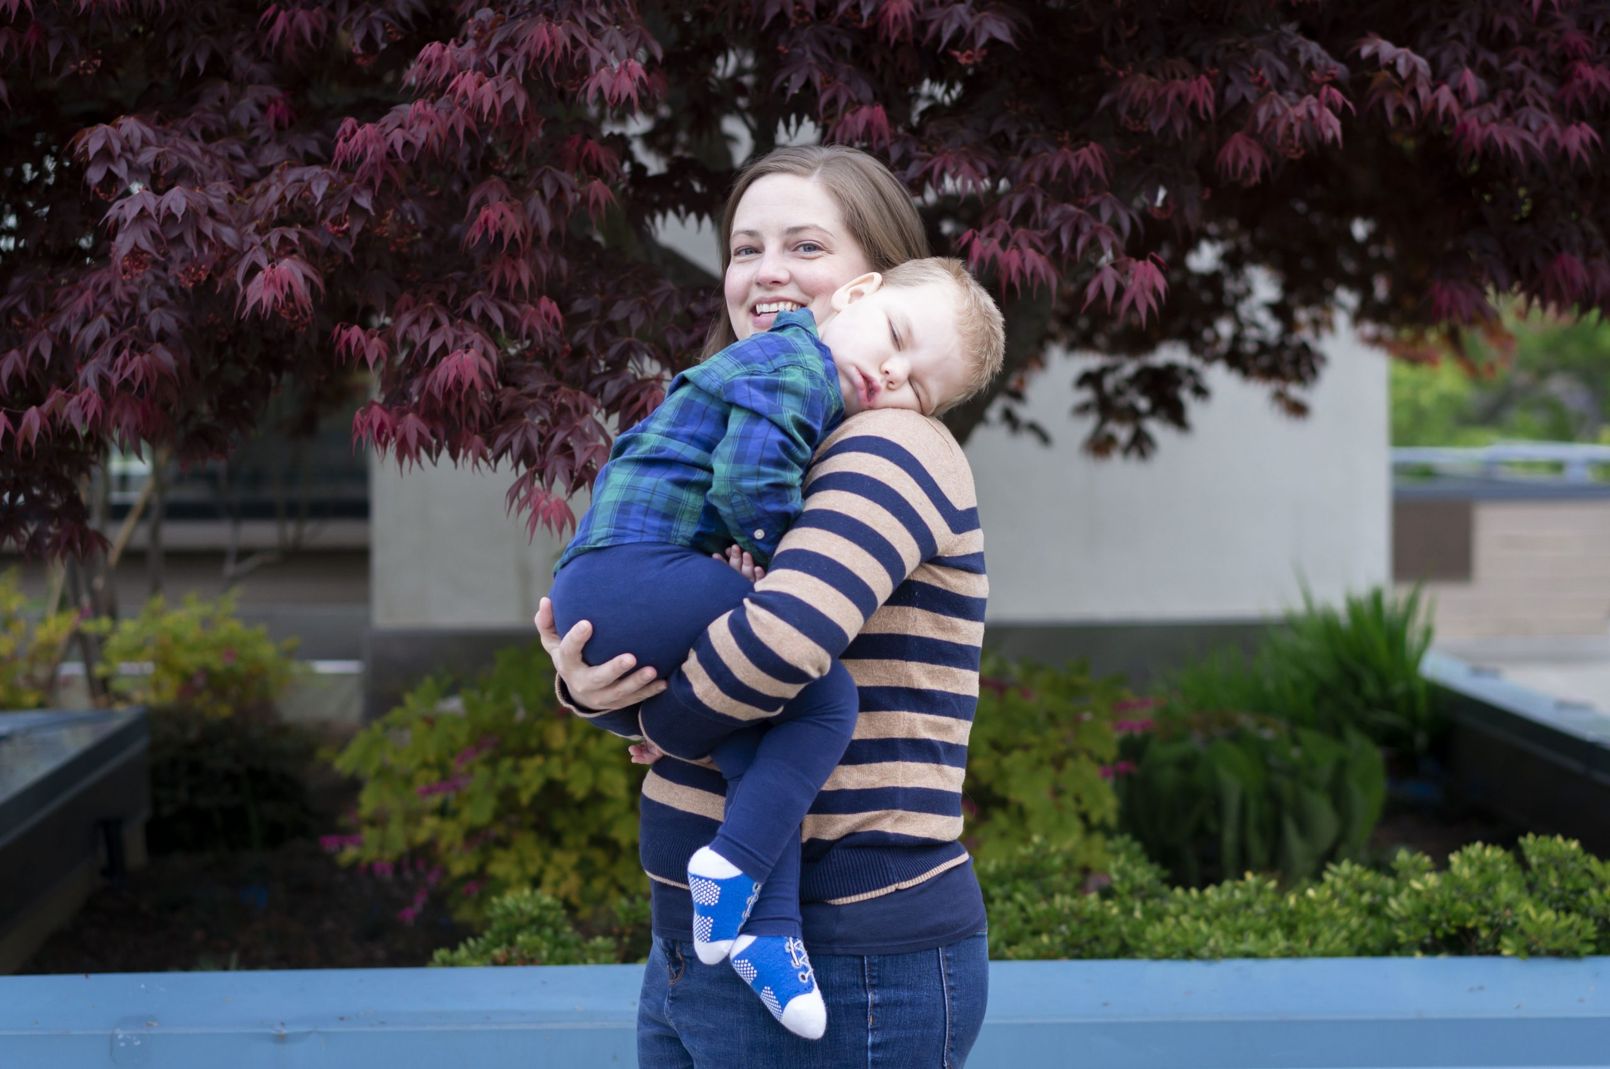
Every provider interacting with a parent in the world of medical complexity, from a patient scheduler to a lab tech to a researcher, should have some language to ask for, encourage, or reinforce the role of parents and caregivers as essential influencers in the child’s plan of care.
Liz, Colton’s mom
www.courageousparentsnetwork.org
@courageousparentsnetwork
Notes:
To change photos:
Click ‘Insert’ in top left corner
Click the pictures drop down menu just below, and pick a method to upload your photo to the presentation
Insert your image and align the dimensions to the image on the slide
Clean up your work by deleting the image that sits below the image you just uploaded

Slide 9
Shared decision making
Burden of decision making
Wrapped in a fear of future guilt or regret
May be juggling others’ opinions
Parents’ decision-making style vs. clinician communication style
@courageousparentsnetwork
www.courageousparentsnetwork.org
Notes:
Anticipatory guidance is delivered by pediatricians, but what does it look like for families of children with medical complexity.

Slide 10
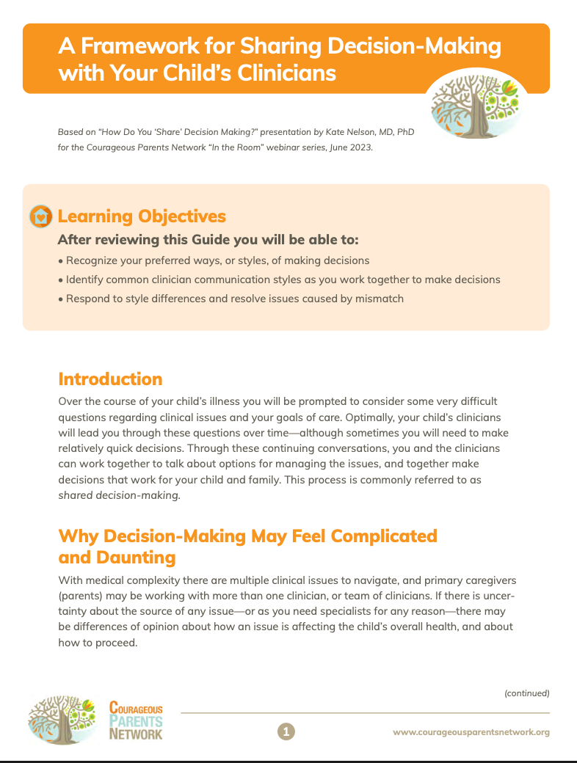
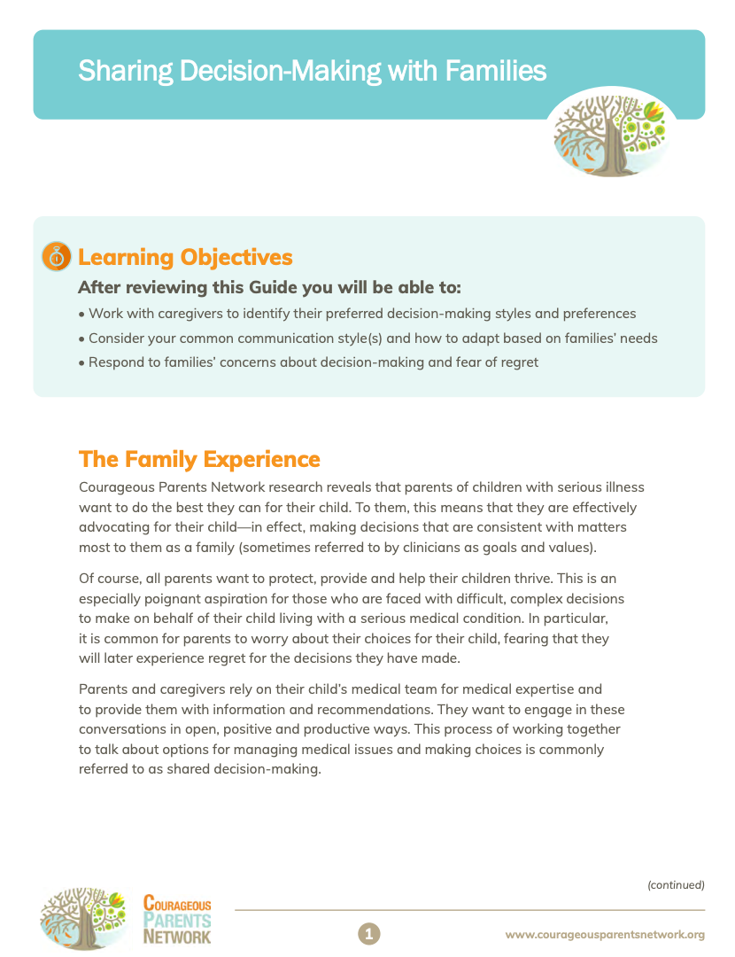
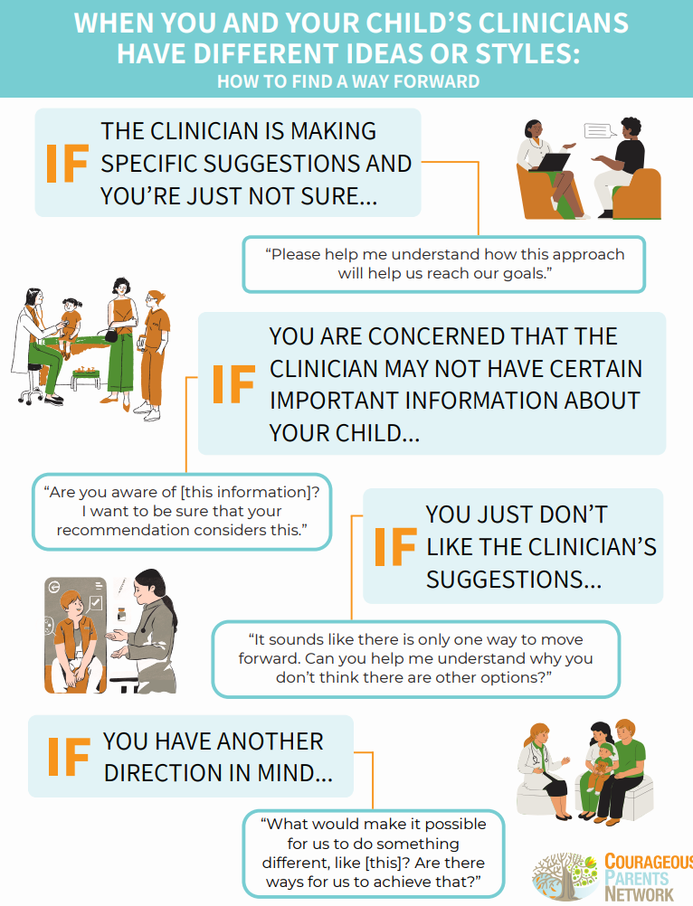
@courageousparentsnetwork
www.courageousparentsnetwork.org
Notes:
VIDEO TEMPLATE
Click ‘insert’ in the top left corner
Click the dropdown associated with ‘Video’ on the right end of the tool bar
If using a video from the web, select Online Movie’ and enter your desired URL
If using a video from your computer, select ‘Movie from file’ to browse videos being held on your device
Once the video is on the page you can manipulate it’s size until everything works at it’s best.

Slide 11
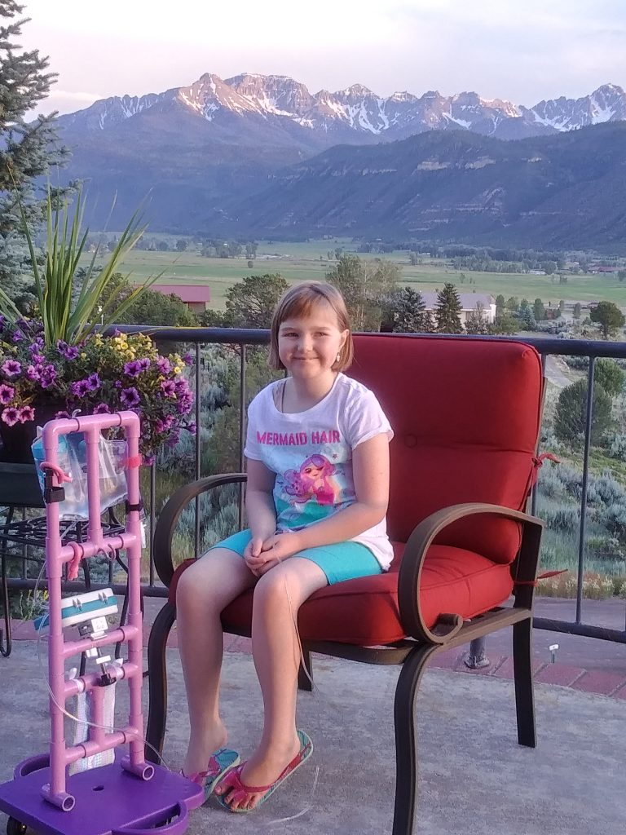
After the newness wears off, things start to feel normalish, or normal-adjacent as I like to say, as her medical care eventually become part of the routine. What actually wears me down is the never-ending care coordination and advocacy required to get her the care she needs. Whether it be quick and simple things like sending messages to her medical team to follow up on something minor, or complex and time consuming things like coordinating all the pieces necessary for her to go to school, it feels like a majority of my time and energy is consumed by advocacy.
Amanda, Andalyn’s mom
www.courageousparentsnetwork.org
@courageousparentsnetwork
Notes:
To change photos:
Click ‘Insert’ in top left corner
Click the pictures drop down menu just below, and pick a method to upload your photo to the presentation
Insert your image and align the dimensions to the image on the slide
Clean up your work by deleting the image that sits below the image you just uploaded

Slide 12
Being an advocate
Parents desire to advocate for their child and family
Parents are experts on their child and family
Can be perceived as anger or hostility - or misunderstanding
Rooted in values and what matters most
@courageousparentsnetwork
www.courageousparentsnetwork.org
Notes:
Parent have a strong desire to advocate for their child. It is a core part of feeling like they are being a “good parent” to their child.

Slide 13
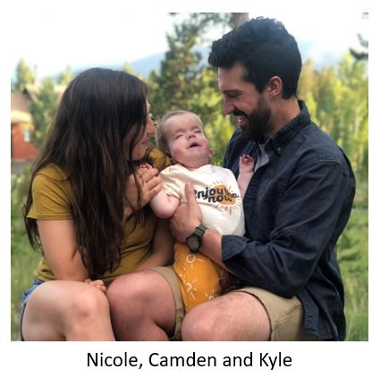
Fifteen months into my journey with Camden, I had not been able to fathom the breadth or speak to the depth of the isolation and otherness that I felt. That is, until I was walking in the golden afternoon light of a crisp October afternoon, flanked by Julie and Melissa. Life with Camden had thus far felt terribly fleeting and ethereal, but with these women I found something more akin to groundedness, sustenance, a way through.
Nicole, Camden’s mom
www.courageousparentsnetwork.org
@courageousparentsnetwork
Notes:
To change photos:
Click ‘Insert’ in top left corner
Click the pictures drop down menu just below, and pick a method to upload your photo to the presentation
Insert your image and align the dimensions to the image on the slide
Clean up your work by deleting the image that sits below the image you just uploaded

Slide 14
The right kind of social support
Many parents experience isolation
Previous social supports may no longer be available
Some social supports, while well-intended, don’t “get it”
Where can you find support or community that works for you?
@courageousparentsnetwork
www.courageousparentsnetwork.org
Notes:
GET CREATIVE
Patient organizations, books, CPN videos,

Slide 15
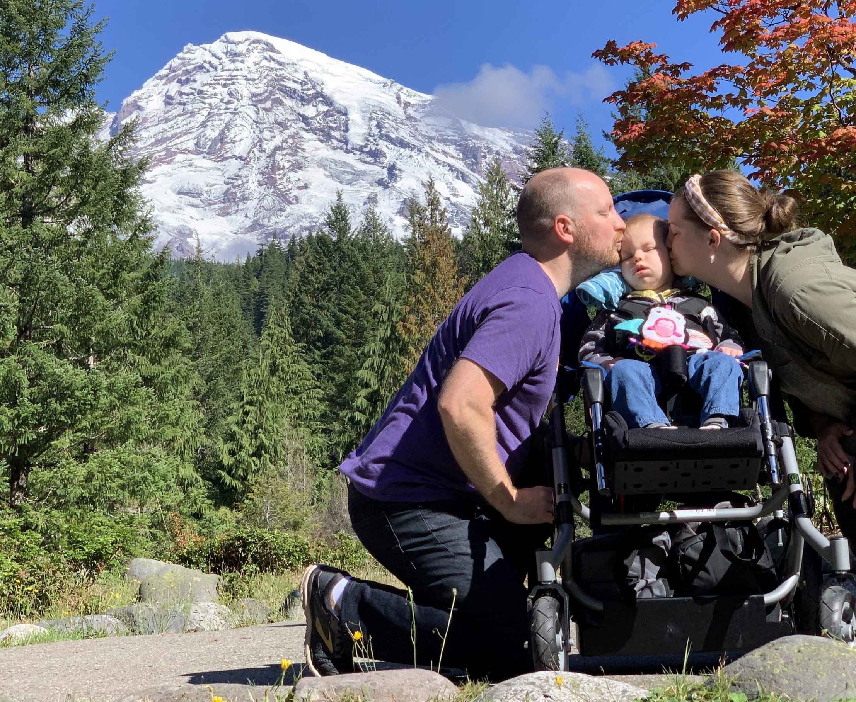
I realized the important differentiating factor between them and our son’s doctors: our son’s doctors are (rightly) focused on the physical manifestations of his disease. The palliative care providers help us focus on all the other ways those manifestations impact his, and our, lives – in our heads, in our hearts, in our home.
Liz, Colton’s mom
www.courageousparentsnetwork.org
@courageousparentsnetwork
Notes:
To change photos:
Click ‘Insert’ in top left corner
Click the pictures drop down menu just below, and pick a method to upload your photo to the presentation
Insert your image and align the dimensions to the image on the slide
Clean up your work by deleting the image that sits below the image you just uploaded

Slide 16
Pediatric palliative care
Not the same as Hospice care
Focus is on maximizing quality of life and minimizing suffering
Can support decision making, communication with the medical team, and more.
@courageousparentsnetwork
www.courageousparentsnetwork.org
Notes:
I was already very good at advocating for Andalyn but I never dared consider the idea of advocating for myself until a palliative care doctor came into my world. Her medical team frequently anticipated problems offering solutions before I could even ask for help. Even so, there was a lot I never said either because I didn’t know exactly what I needed or because I was too scared I would be misunderstood. I have learned the hard way that in the medical world big feelings and too much honesty have a way of making boundaries and invisible walls appear where openness and comfortability once was. Palliative care became a valuable resource facilitating communication with her medical team, especially around difficult topics, so my needs could be better received. - Amanda

Slide 17
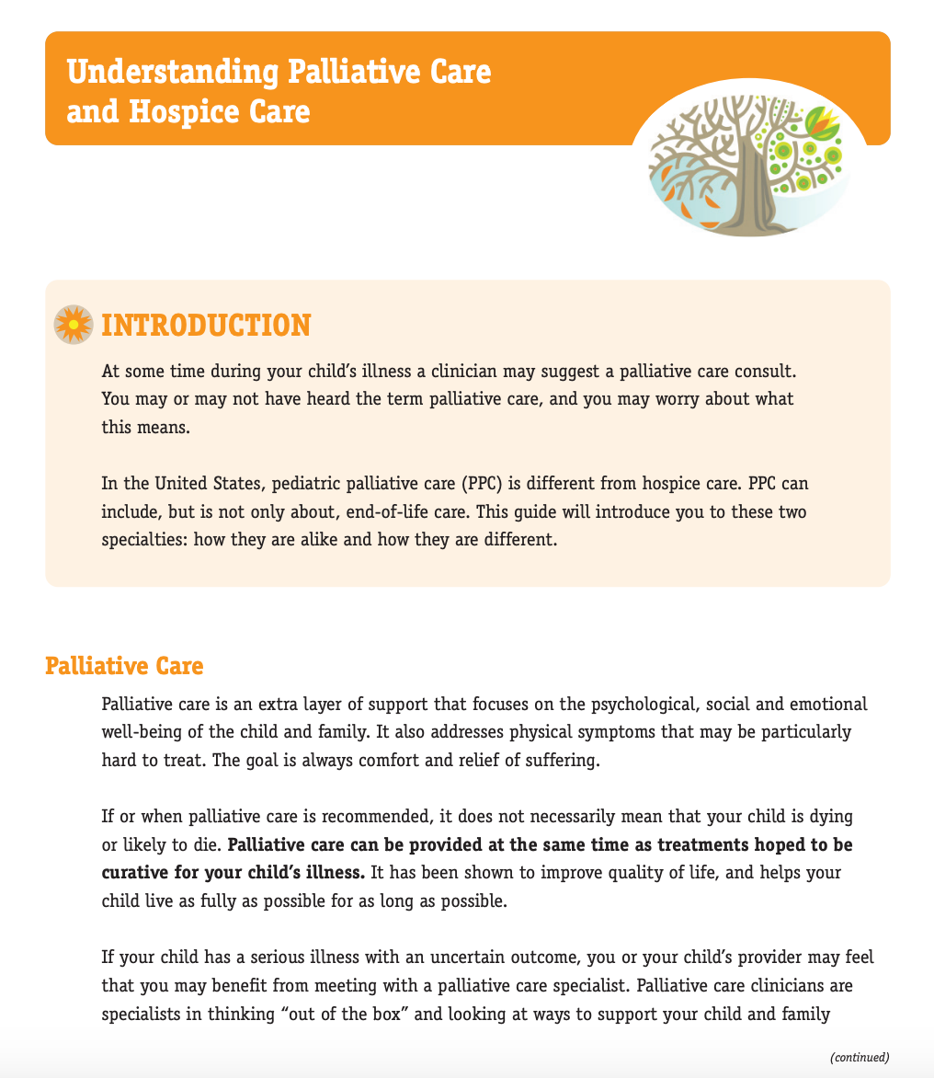
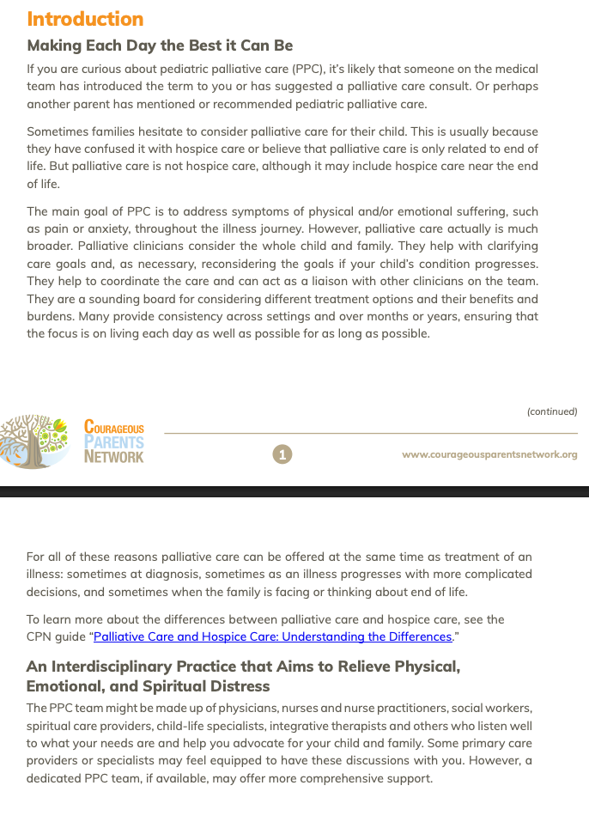
@courageousparentsnetwork
www.courageousparentsnetwork.org
Notes:
VIDEO TEMPLATE
Click ‘insert’ in the top left corner
Click the dropdown associated with ‘Video’ on the right end of the tool bar
If using a video from the web, select Online Movie’ and enter your desired URL
If using a video from your computer, select ‘Movie from file’ to browse videos being held on your device
Once the video is on the page you can manipulate it’s size until everything works at it’s best.

Slide 18




QR CODES
Chrissy@courageousparentsnetwork.org
CourageousParentsNetwork.org
NeuroJourney.org
CopingWithLoss.org
MedicalComplexity.org

