Slide 1

Medicaid,Medicaid Waivers, and medically complex youth in new York State
Kathleen Downes, LMSW, BCPA-NYS

Slide 2
NYS Definition of Medically Fragile Child
“Medically fragile child" means an individual who is under twenty-one years of age and has a chronic debilitating condition or conditions, who may or may not be hospitalized or institutionalized, and meets one or more of the following criteria:
is technologically dependent for life or health sustaining functions,
requires a complex medication regimen or medical interventions to maintain or to improve their health status, or
is in need of ongoing assessment or intervention to prevent serious deterioration of their health status or medical complications that place their life, health or development at risk.
Chronic debilitating conditions include bronchopulmonary dysplasia, cerebral palsy, congenital heart disease, microcephaly, pulmonary hypertension, and muscular dystrophy. The term "medically fragile child" shall also include traumatic brain injury
Source: Source: N.Y. Pub. Health Law § 4401(9)

Slide 3
What is Medicaid?
A public health insurance program for people who are low-income and/or who have a disability.
It is the primary funder for long-term home care services such as personal care services (PCS) and consumer directed personal assistance services (CDPAS).
In New York, you are automatically eligible for Medicaid if you receive Supplemental Security Insurance (SSI)→ common pathway for medically complex people
Source: Benefits Plus Learning Center (2024). MAGI Medicaid vs. Non-MAGI Medicaid. Retrieved from https://bplc.cssny.org/pbm/health-programs/medicaid/magi-medicaid-vs-non-magi-medicaid

Slide 4
Major Medicaid eligibility groups
”MAGI” or “Obamacare” type
Non-MAGI or “Aged, Blind, and Disabled” type
Most medically complex people fall in the latter category
Source: Benefits Plus Learning Center (2024). MAGI Medicaid vs. Non-MAGI Medicaid. Retrieved from https://bplc.cssny.org/pbm/health-programs/medicaid/magi-medicaid-vs-non-magi-medicaid

Slide 5
Get help enrolling in Medicaid
A facilitated enroller can assist. In NYS, Community Health Advocates has a network across the state
Go to the local Department of Social Services (in NYC, called the Human Resources Administration or “HRA”)
Source: Benefits Plus Learning Center (2024). MAGI Medicaid vs. Non-MAGI Medicaid. Retrieved from https://bplc.cssny.org/pbm/health-programs/medicaid/magi-medicaid-vs-non-magi-medicaid

Slide 6
Fee for service (“Straight”) vs. managed care medicaid
In straight Medicaid, providers bill Medicaid directly every time they provide services. You can see any doctor in the NYS Medicaid network
In managed Medicaid, you must stay in the plan’s network and follow the plans rules for care. A primary care provider writes referrals for specialists, prior authorizations for non-emergency hospital visits. Providers bill the plan (private companies administer the plan). Most services are through the managed care plans
Holtzman, R. (2024, October 29). Presentation for Dancing Dreams. [Presentation].

Slide 7
Types of Medicaid managed care
Mainstream managed care: For most enrollees who are not on Medicare, do not have a spend down, do not have other primary insurance, also used by children under age 21
_________________________AGE 21+__________________________
Managed long term care plans “partial capitation”: For most enrollees with Medicare and Medicaid age 21+ who need long term care services for 120+ days such as in-home nursing, PT, OT, ST, personal care services (inc. consumer directed), home health aides etc.
“Full capitation”: cover ALL Medicare and Medicaid services in one plan. Must need a nursing home level of care and must stay in network (give up Medicare Advantage/Original Medicare card for a new card
Source: New York Health Access (2024). Managed long term care. Retrieved from http://health.wnylc.com/health/entry/114/#3%20capitation

Slide 8
CHOOSING a Medicaid managed care plan
When you apply, pick a plan based on your needs or one will be chosen for you
All new enrollments are locked into their choice for 9 months unless they prove “good cause”
After that, you can switch for any reason at any time
Source: New York Health Access (2024). Medicaid managed care. Retrieved from http://health.wnylc.com/health/entry/160/#1%20what%20is%20managed%20care

Slide 9
Excluded
(cannot enroll into a managed care plan)
Exempt
(can choose to enroll into a managed care Plan)
Source (full list): https://www.health.ny.gov/health_care/managed_care/plans/docs/mmc_excl_exempt_chart.pdf
Kids in receipt of comprehensive private health insurance (e.g., through parent’s job)
Kids < 21 who are in Long Term Placement in a nursing home
Kids enrolled in one of the waivers: OPWDD, Children’s, TBI, NHTD
Kids expected to be Medicaid eligible for less than 6 months (except pregnant people)
Kids who are OPWDD eligible (e.g., have a developmental disability)
Kids eligible for Emergency Medicaid only: primarily undocumented immigrants
Kids receiving hospice services at time of enrollment
Kids who are Native American or Alaskan Native

Slide 10

What should I do if I want or need to be disenrolled from managed care?
**DO NOT MAKE THIS DECISION WITHOUT CONSULTING YOUR TEAM**
Call NYS Medicaid Choice at (800) 505-5678 and tell them you need an exemption/exclusion form. Make sure you are clear that you are NOT disenrolling from Medicaid overall; you are only disenrolling from Medicaid Managed Care.
Source: MFY Legal Services (n.d.) How do I get out of Medicaid managed care if I need to? Retrieved from https://mobilizationforjustice.org/wp-content/uploads/facts/Medicarecaid-GetOutManagedCare.pdf

Slide 11
Ways that kids access medicaid
Supplemental Security Insurance (SSI) benefits
Cash benefits from HRA
If the family is low income
They have certain disabilities (family income not considered)
Babies under 1 year, if the birthing parent was covered by Medicaid at delivery
Holtzman, R. (2024, October 29). Presentation for Dancing Dreams. [Presentation].

Slide 12
Health homes serving children and medicaid
A health home is an umbrella term for an entity that contracts with various care management agencies (CMAs). Care managers work at CMAs. There is no centralized list of CMAs—call each health home and find out what CMAs are included and who has availability. You can ask for a new care manager if you are unhappy.
Health home eligibility is for those chronic health conditions (usually two or more) and active Medicaid
Comprehensive care management- assess needs, make a care plan
Care coordination- work with providers
Transitional services- assist when ready to move to new programs
Family support- help with appointments and meetings
Referral to community services- find other services that are beneficial
Health homes in New York State: You can see a list of all HHSCs by county here: https://www.health.ny.gov/health_care/medicaid/program/medicaid_health_homes/hh_map/index.htm
If you have questions about HHSCs, you can email: HHSC@health.ny.gov
Holtzman, R. (2024, September 12). Medicaid managed care landscape for medically fragile children in NYC. [Presentation]
New York State Department of Health (2021). Medicaid and the children’s waiver (2021). Retrieved from https://www.health.ny.gov/health_care/medicaid/redesign/behavioral_health/children/docs/medicaid_childrens_waiver_webinar_1.2021.pdf

Slide 13
What is a Medicaid waiver?
A program that “waives” some requirements typically imposed on all recipients
Sometimes income requirements are more flexible
Sometimes waivers offer extra services (Community habilitation, day habilitation, vehicle modifications, home modifications)
Waivers are not an entitlement and are authorized at government discretion (and slot availability)
Source: New York Health Access (2024). Medicaid home-and-community-based waiver programs in New York State. Retrieved from http://health.wnylc.com/health/entry/129/
Medicaid.Gov (2024). New York waiver fact sheet. Retrieved from https://www.medicaid.gov/medicaid/section-1115-demo/demonstration-and-waiver-list/Waiver-Descript-Factsheet/NY
https://www.medicaid.gov/medicaid/section-1115-demo/demonstration-and-waiver-list/82656
https://www.medicaid.gov/medicaid/section-1115-demonstrations/downloads/ny-medicaid-rdsgn-team-appvl-01092024.pdf

Slide 14
CHILDREN’s Medical HCBS WAIVER
A waiver for youth with complex healthcare needs up to age 21
Designed to prevent institutionalization and keep young people in community settings: must have institutional level of care
Major eligibility groups:
-Medically fragile children
-Developmentally disabled and medically fragile
-Developmentally disabled and in foster care
-Serious emotional disturbance
*Parental income not usually counted (family of one budgeting)*
Source: New York State Department of Health (2021). Medicaid and the children’s waiver (2021). Retrieved from https://www.health.ny.gov/health_care/medicaid/redesign/behavioral_health/children/docs/medicaid_childrens_waiver_webinar_1.2021.pdf

Slide 15
CHILDREN’s Medical HCBS WAIVER POINTs of ACCESS
If not yet enrolled in Medicaid, call CYES at 833-333-2937 to inquire about waiver enrollment
If already in Medicaid and eligible for a health home→ ask health home care coordinator about a referral for waiver enrollment
Those already enrolled in Medicaid who are suspected to be waiver eligible will be referred to health homes for assistance
Not all young people eligible for a health home will qualify for a waiver, but all young people in the waiver are automatically eligible for a health home
Source: New York State Department of Health (2021). Medicaid and the children’s waiver (2021). Retrieved from https://www.health.ny.gov/health_care/medicaid/redesign/behavioral_health/children/docs/medicaid_childrens_waiver_webinar_1.2021.pdf

Slide 16
Role of health homes in children’s medical hcbs waivers
Comprehensive care management- assess needs, make a care plan**
Care coordination- work with providers
Transitional services- assist when ready to move to new programs
Family support- help with appointments and meetings
Referral to community services- find other services that are beneficial
Monthly check-ins
**Care management is required in this waiver→ most get care management through health homes**
You can opt out of health homes, but most families do not.
If you do opt out of health homes you must receive care management through:
CYES ( fee-for-service Medicaid cases)
Medicaid managed care plan (managed care Medicaid cases)
Quarterly check-ins
Source: New York State Department of Health (2021). Medicaid and the children’s waiver (2021). Retrieved from https://www.health.ny.gov/health_care/medicaid/redesign/behavioral_health/children/docs/medicaid_childrens_waiver_webinar_1.2021.pdf

Slide 17
Annual recertification
Level of care is valid for 365 days
Your care manager will do your recertification
Process usually begins 2 months before expiration
Source: New York State Department of Health (2021). Medicaid and the children’s waiver (2021). Retrieved from https://www.health.ny.gov/health_care/medicaid/redesign/behavioral_health/children/docs/medicaid_childrens_waiver_webinar_1.2021.pdf

Slide 18
What is opwdd?
The Office for People with Developmental Disabilities (OPWDD) is a New York State agency that facilitates the coordination of services and supports for people with intellectual and or developmental disabilities. OPWDD services are provided by state and nonprofit providers contracted to support people with disabilities.
Source: OPWDD, n.d.

Slide 19
Front door offices by region (downstate)
Front Door Office Long Island: 631-434-6000 (Region 5)
Counties served: Nassau, Suffolk
New York City (Region 4)
Front Door Office Queens: 718-217-6485
Front Door Office Brooklyn: 718-642-8576
Front Door Office Manhattan: 646-766-3220
Front Door Office Bronx: 718-430-0757
Front Door Office Staten Island: 718-982-1913
Source: In the driver’s seat (2024). Front door. Retrieved from https://inthedriversseat.org/first-gear/front-door/

Slide 20
OPWDD Eligibility Basic criteria
Intellectual disability, epilepsy, cerebral palsy, autism, familial dysautonomia, neurological disorders related to central nervous system
Permanent
Onset before age 22
Substantially interferes with daily living (IQ below 60 + two adaptive behaviors in the low range, IQ above 60 + three adaptive behaviors in the low range
Source: Office for People with Developmental Disabilities (2024). Determining eligibility for services: Substantial handicap and developmental disabilities. Retrieved from https://opwdd.ny.gov/system/files/documents/2023/12/eligibility_guidelines-final.pdf p. 3

Slide 21
Evaluations & Required paperwork
IQ test with a narrative explaining the results (done within 3 years)- not abbreviated, AND adaptive behavior scores
Adaptive behavior tests
Psychosocial (done within 1 year)
If other than intellectual disability, a medical report done within 1 year)
Transmittal form
For autism, specialty autism assessment (Autism Diagnostic Observation Schedule or ADOS, Childhood Autism Rating Scale or CARS)
Source consulted: Administrative directive 2023: Individual eligibility and enrollment for the office for people with developmental disabilities (OPWDD) home and community-based services (HCBS) 1915(c) waiver and requests for service authorization. Retrieved from https://opwdd.ny.gov/system/files/documents/2023/07/final-waiver-enrollment-and-eligibilty-adm_7.17.pdf p. 4
Source: Office for People with Developmental Disabilities (2024). Determining eligibility for services: Substantial handicap and developmental disabilities. Retrieved from https://opwdd.ny.gov/system/files/documents/2023/12/eligibility_guidelines-final.pdf p. 5, p. 10

Slide 22
Care COORDINATION organizations (CCO)
The main CCOs are Advance Care Alliance and Care Design
Partners Health Plan is only available if you are 21+, eligible for Medicare and Medicaid
A care manager should be assigned to help you submit for eligibility
If you are not yet on Medicaid, you may also use a service access agency to help you pursue initial eligibility
Source consulted: INCLUDEnyc (2024). Care coordination organization. Retrieved https://includenyc.org/help-center/resources/care-coordination-organization/

Slide 23
Main OPWDD SERVICES: HCBS WAIVER vs. Family Support Services
Family support services (FSS) do not require Medicaid—the waiver does
The waiver is more comprehensive—FSS has a $3000 annual cap (July 1-June 30 for NYC and January 1-December 31 for other regions)
Waivers require a care manager; FSS makes care management optional
FSS can consider parental income for prioritization of requests
Source consulted: OPWDD Administrative Directive (2022). Family support services reimbursement guidelines. Retrieved from https://opwdd.ny.gov/system/files/documents/2022/06/fss-final-adm-revised-6.27.22-rev.pdf p. 3-5

Slide 24
Opwdd waiver criteria
Have a developmental disability that originated before age 22
Need a level of care that is equivalent to that provided in an Intermediate Care Facility for I/DD
Medicaid eligible
Appropriate residential setting: family home, OPWDD- certified community residence, individualized residential alternative (IRA), OPWDD- certified family care home
Not enrolled in another waiver or managed LTC plan
You can ask for a waiver of “parental deeming” for an applicant under age 18
Source consulted: Administrative directive 2023: Individual eligibility and enrollment for the office for people with
developmental disabilities (OPWDD) home and community-based services
(HCBS) 1915(c) waiver and requests for service authorization. Retrieved from https://opwdd.ny.gov/system/files/documents/2023/07/final-waiver-enrollment-and-eligibilty-adm_7.17.pdf p. 3-5

Slide 25
Reasonable indication of need
An OPWDD waiver requires a reasonable indication of need, which varies by age
To summarize, an applicant must prove a need for services beyond what is offered by Early Intervention, CPSE, the school district, and informal supports
Children under age 8-12 less likely to qualify
Source consulted: Administrative directive 2023: Individual eligibility and enrollment for the office for people with developmental disabilities (OPWDD) home and community-based services (HCBS) 1915(c) waiver and requests for service authorization. Retrieved from https://opwdd.ny.gov/system/files/documents/2023/07/final-waiver-enrollment-and-eligibilty-adm_7.17.pdf
p. 6
https://opwdd.ny.gov/system/files/documents/2021/09/hcbs-waiver-application-requirements-for-parental-deeming.pdf

Slide 26
OPWDD Waiver next steps
Intermediate care facility level of care
A staff member at the CCO will prepare the waiver application and send it to OPWDD for review
If not yet on Medicaid, the application is sent to DSS after the waiver is approved (up to 90 days)
Once Medicaid and all waiver documents are approved, services begin on the 1st of the following month
Source: Care Design NY (2024). ENROLLMENT PROCESS CHECKLIST FOR PROSPECTIVE MEMBERS. Retrieved from https://caredesignny.org/images/Graphics/Prospective_Member_Enrollment_Process_Checklist.pdf

Slide 27
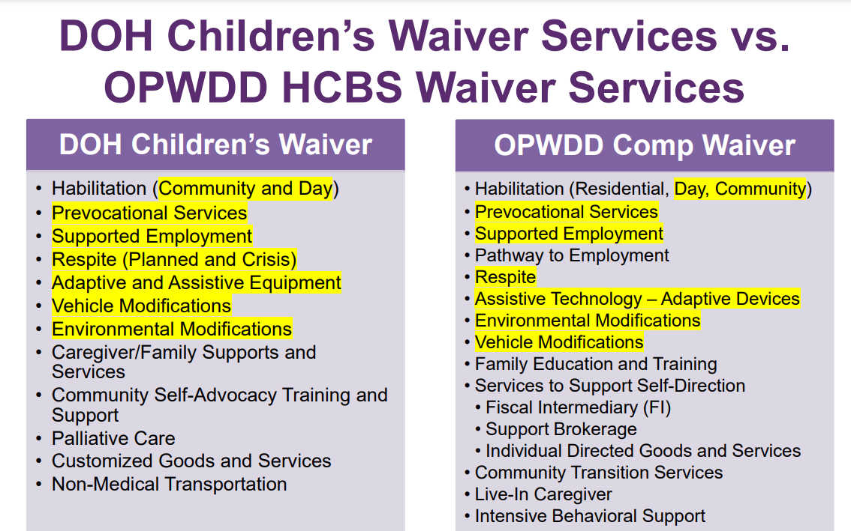
Comparison of main waivers for medically complex people
The slide (shown above) can be found as slide #11 of this slide deck from 5/5/21: https://www.health.ny.gov/health_care/medicaid/redesign/behavioral_health/children/docs/cco_overview.pdf
Holtzman, R. (2024, October 29). Presentation for Dancing Dreams. [Presentation].
As of 2022, CFSS and CSATS have been consolidated into one service called Caregiver/ Family Advocacy and Support Services (CFASS). See page 35 of this doc.

