Slide 1

Community Based Palliative Care Services
Presented by: Danielle Toto, LMSW
Social Work & HCBS Waiver Palliative Care Program Supervisor
St. Mary’s Home Care

Slide 2
Home & Community Based Services Children’s Waiver (HCBS)
Medicaid Waiver program for the following populations:
Medically Fragile/Developmental Disability
Medically Fragile/Developmental Disability in Foster Care
Medically Fragile / Complex Medical Condition
— AND the condition must place the child at imminent risk of hospitalization or institutionalization, or require supports to transition back to the community after discharge.
*this waiver is for children & youth ages 0-21

Slide 3
Palliative Care Suite of Services
Service | Purpose | Examples
Expressive Therapy | Emotional support through creative modalities. | Art therapy, music therapy, play-based emotional support.
Counseling & Support (includes Bereavement Support) | Mental health and emotional support for serious illness. | Family counseling, child counseling.
Massage Therapy | Comfort and symptom relief. | Therapeutic massage for pain, stress, comfort.
Pain & Symptom Management | Non‑curative support to improve quality of life. | Pain control strategies, symptom monitoring.

Slide 4
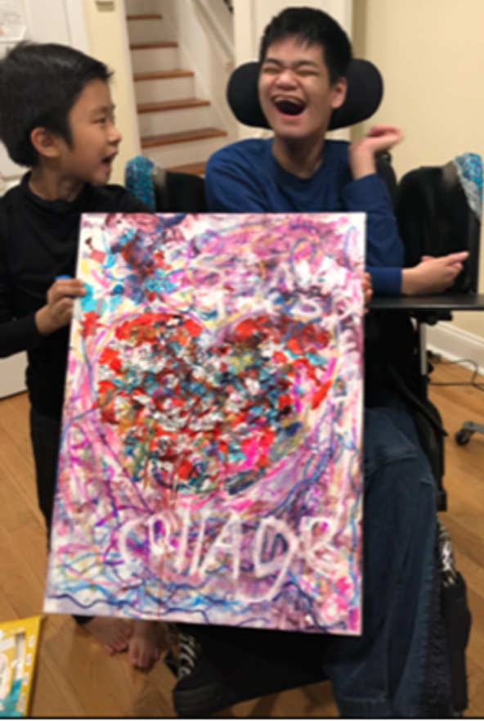
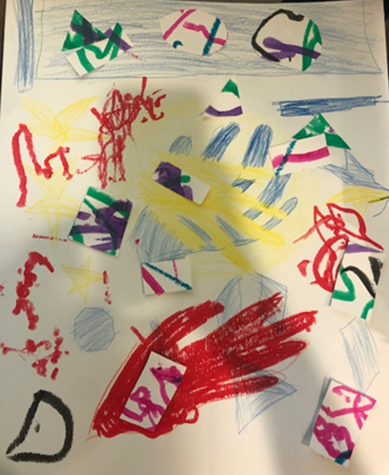
Patient Experience: Expressive Therapy
Goal: Provide a mechanism for family bonding
Intervention: Weekly art-based sessions in the home
Outcome: The family reported that expressive therapy provided a meaningful shift away from routine, task focused medical caregiving, allowing them to bond with their child through joyful, creative activities and experience connection beyond day to day medical needs. The artwork created by their child served as a visual narrative of his life that they could always treasure

Slide 5
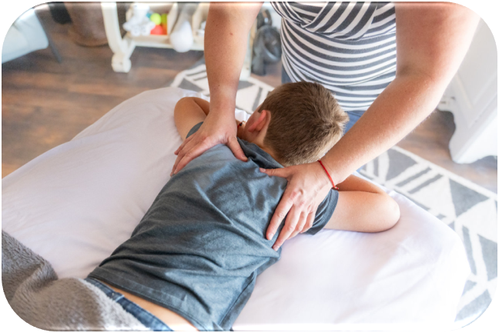

Patient Experience: Massage Therapy & Counseling & Support Service
Goal: Decrease chronic myofascial pain in respiratory muscles and improve quality of life;
Prevent caregiver fatigue and support safe maintenance of the child in the home environment
Intervention: Massage therapy 2 times per week; counseling 1 time per month
Outcome: Child experienced improved comfort and quality of life, while the caregiver demonstrated strengthened coping capacity, supporting safe and sustained care within the home environment.

Slide 6
How Do I Get Palliative Care Services for My Child?
No matter where you're starting, we're here to help guide you through the process.
My Child Has Medicaid
AND a Health Home Care Manager
My Child Has Medicaid
BUT No Health Home Care Manager
My Child Does NOT
Have Medicaid
You're already on the pathway!
• Talk to your Care Manager
• Ask about HCBS eligibility
• Request a Palliative Care
referral
Connect with a Health Home.
• Get a Care Manager
• Complete HCBS Eligibility process
• Request Palliative Care services
Your Care Manager will make a referral
Start Here.
Contact the DOH Child & Youth Evaluation Services (CYES)
Complete HCBS eligibility process
Apply for Medicaid
Connect with a Health Home
Access services
Not sure where to start? Talk with your medical providers, social worker, care manager, or palliative care team. We can help.
Notes:
[Sources]
Updated for 3-pathway model.

Slide 7
Contact Information
Danielle Toto, LMSW
HCBS Waiver Palliative Care Program Supervisor
St. Mary’s Home Care
Phone: 631-755-1809
Email: dtoto@stmaryskids.org
Yaneth Velez
Program Assistant
St. Mary’s Home Care
Phone: 631-755-1806
Email: yvelez@stmaryskids.org

