Slide 1

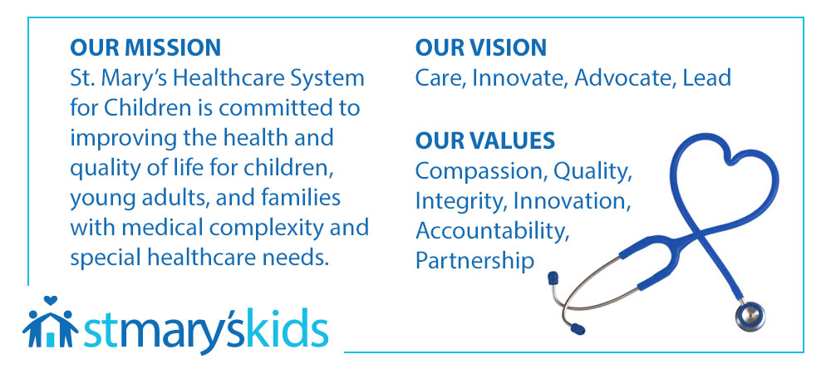

Mission • Vision • Values
St. Mary's Healthcare System for Children
COMPASSIONATE CARE PATHWAY &
THE FUTURE OF PALLIATIVE CARE

Slide 2
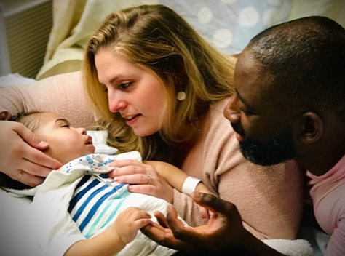
Objective
Gain an understanding of our new Compassionate Care Program, which includes:
    Pre-admission workflow
    Rubric assessment tool
    4 Level Compassionate Care
    Compassionate Care Pals

Slide 3

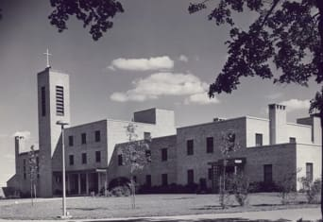
Pediatric Palliative Care Program
HISTORY OF OUR PALLIATIVE CARE PROGRAM
1870
Founded in Manhattan by the Sisters of the Community of St. Mary, the then 15-bed St. Mary’s was New York City’s first hospital for acutely ill children—a mission we have continued for 150 years
1984
Designated palliative care unit opens. We initiate the nation’s first pediatric palliative care
1950
Need for larger facility move to Bayside campus
2025
Launch of Compassionate Care Pathway and Pals
1870
1951
2025

Slide 4
THE PALLIATIVE CARE STRUCTURE:
AN INTERDISCIPLINARY TEAM APPROACH
Palliative Care Structure
Interdisciplinary
Ethics
Pain Management
Complementary Care
Management Council
Executive Team
Rehabilitation
Nursing
Mental Health
Volunteers
School
Nutrition
Therapeutic Activities
Medicine
Pastoral Care
External Liaisons
Foundation
Academic and Community Partnerships

Slide 5
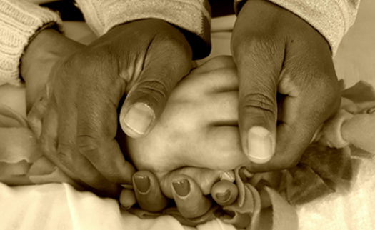
Palliative Care to Compassionate Care
EVOLVING PALLIATIVE CARE AT ST. MARY’S
PALLIATIVE CARE PATHWAY
COMPASSIONATE CARE PATHWAY
TO
Established in 2002​
3 Level Pathway​
Subjective assessment​
Interdisciplinary team workflow​
Protocol for change in level​
Misconception …Palliative
Care​ is not hospice!
Established in 2025​
Compassionate Care Pathway​
Introduction of Level 4: Hospice​
- New Pre-admission workflow​
- Developed Rubric (Objective tool)​
- Compassionate Care Pals​
Clear interventions/outcomes per level
Clear roadmap from admission to d/c or EOL

Slide 6




Compassionate Care Pathway
LEVELS OF CARE, COMPASSIONATE CARE PATHWAY
LEVEL 1 : PRIMARY SUPPORTIVE CARE Child is stable, working toward independence, or at baseline function. Pain is managed well and does not impede on quality of life (QOL) or activities of daily living (ADLs)/mobility. Education for families on Compassionate Care Pathway at SMH Adjustment period to SMH If coming in with MOLST, discussion with care team to ensure parents’ wishes are clear | LEVEL 2 : SPECIALIZED SUPPORTIVE CARE Advanced symptom management to maintain QOL and independence in ADLs/mobility. Still participates in school and daily activities. Continued support for family as change in status occurs Explain clinical change /Goals of care discussion Focus on legacy building projects/experiences Explain Doula Program | LEVEL 3 : INTENSIVE SUPPORTIVE CARE Child’s medical status has declined to a “new baseline” requiring increased comfort measures to maintain QOL and/or independence in ADLs/ mobility. Goal of treatment may be prolonging life and/or comfort. Continued support/ education with more of a palliative focus Peaceful dying plan (as needed) Explain increased clinical change Additional education re: comfort modalities and pain management Legacy projects completed Offer Doula volunteer | LEVEL 4 : ADVANCED & CONTINUOUS SUPPORTIVE CARE Disease has progressed to end-stage Goal of treatment is comfort Death is imminent/ End of Life / HOSPICE CARE Offer Gentle Transitions Booklet Peaceful Dying plan implemented Life review with family Support child and family throughout dying process Comfort Cart placed in room Transfer to private room 24/7 bedside support by member of palliative team; bereavement support
4

Slide 7
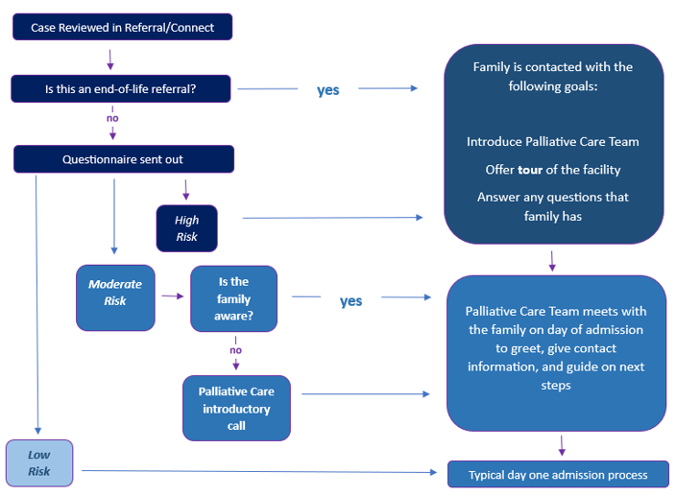
Compassionate Care Pathway
COMPASSIONATE CARE PATHWAY: Identify Appropriate Patients: Pre-Admission Decision

Slide 8

Optimal admission process
Dear Medical Provider,
Thank you for your recent referral to St. Mary’s Hospital for Children. In order to help our team determine the most suitable services for the patient and family, we appreciate you completing the following questionnaire. Please check most appropriate diagnostic criteria below:
◻ New diagnosis, chronic/irreversible diagnosis that is life limiting or life altering.
◻ Showing signs/symptoms of progression of disease (consistent need for increased
intervention related to pain or respiratory support)
to maintain quality of life.
◻ Current treatment plan is no longer effective as disease continues to progress.
◻ Current condition is at end stage. Goal of care is comfort. Death is imminent.
1. Is there a MOLST in place? ◻ Yes (circle all that apply: DNR/ DNI/ DNH) ◻ No
2. Has there been a palliative care meeting held with family? ◻ Yes Date: ____ ◻ No
    What are the parents or designated caregiver’s expectations for their child
at St. Mary's Hospital for Children?
St. Mary’s Hospital for Children

Slide 9
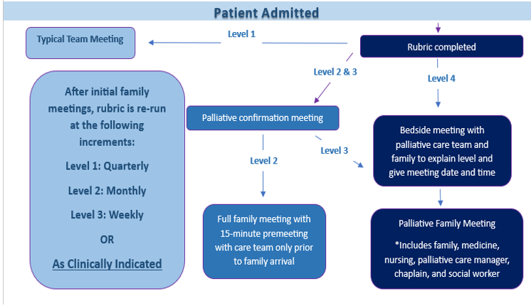
Compassionate Care Pathway
COMPASSIONATE CARE PATHWAY: Admission Workflow

Slide 10
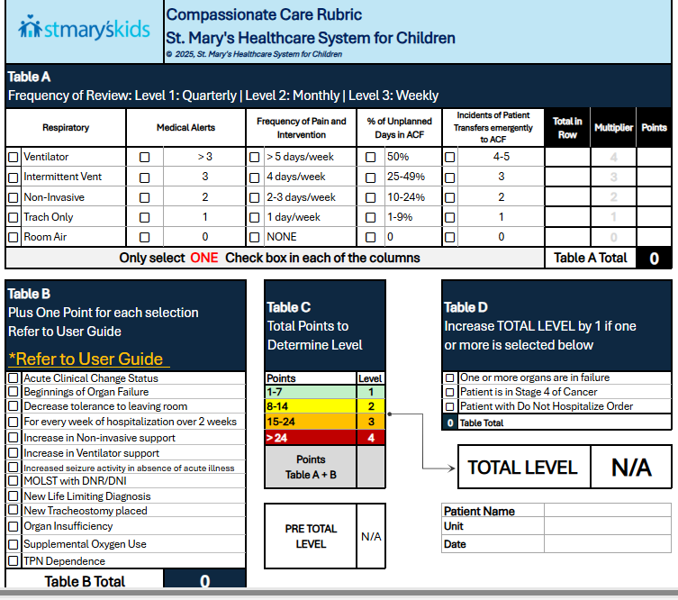
Compassionate Care Rubric
COMPASSIONATE CARE RUBRIC EVALUATION FORM
*RUBRIC will be completed by Medical Provider upon admission and as needed.

Slide 11

Compassionate Care Rubric
NUMBER OF RESIDENTS PRE AND POST RUBRIC
The Number of residents Post-Rubric increased on all units.
Overall, there was a 54% increase in residents Post-Rubric.
△54%

Slide 12
Compassionate Care Rubric
NUMBER OF RESIDENTS BY LEVEL PRE AND POST RUBRIC

Slide 13

Letter from a Mother
Before I started this journey with my son, I never even knew that palliative care existed for children. It’s not an experience that gets talked about. And any time I mentioned to
others who asked about Noah, that he was in a "palliative care" facility, they just
returned this look of sadness and pity.
But that's because they don't know what I now know.
Palliative care isn't a dirty word,
It's not something somber and sad.
It's bright, and celebratory.
Its personal and intimate.
It’s a bridge to finding peace,
in holding tightly to the legacy of your child's life and navigating
all the cornerstones of the excruciating process of one day losing them,
but ultimately knowing that everyone involved in that process brought
dignity and comfort to it.
I wasn't in this mind frame on day one. Far from it, but through the
incredible support of the palliative care team
I have found comfort and peace.
My son receives dignified comfort care, and I'm beyond grateful to
all those who have carried us to this point in our journey.
-Written by a resident’s parent

Slide 14


Vision for the Future
St. Mary’s Vision
More children and families receiving compassionate care
Local outreach to build our compassionate care network
Expansion of services into community

Slide 15



