Slide 1
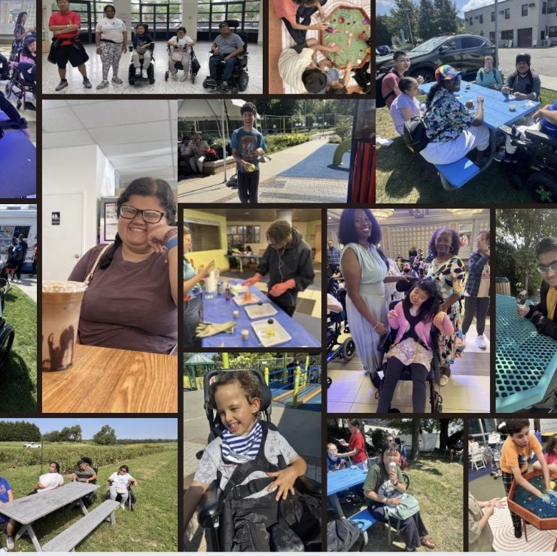

Socialization and Community Connection Through the MDHC program

Slide 2
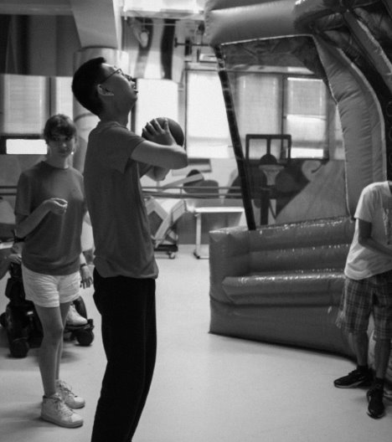

Who we are
St. Mary's Medical Daycare Program provides therapeutic, rehabilitative and recreational activities to help children and young adults with special healthcare needs reach their full potential.
Modeled after New York States Adult Day Healthcare (ADHC) program structure while addressing the unique needs of our pediatric and young adult population.
St. Mary's MDHC program is the only pediatric Medical Day Healthcare Model of its kind in New York State.

Slide 3
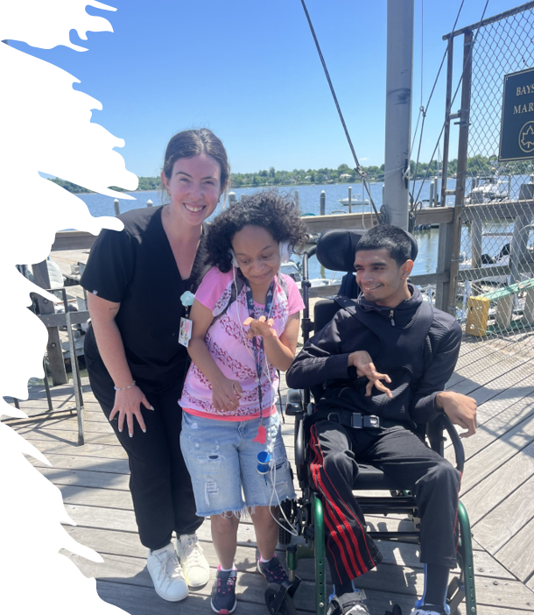
Participant Population
The program provides comprehensive medical day health care services to children adolescents, and young adults ages 5-30+ with complex medical, physical, developmental, and cognitive disabilities.
Participants represent a broad spectrum of abilities and support needs. Some are college graduates and young adults working toward maintaining strength, functional skills, independence, and therapeutic goals, while others require full assistance with activities of daily living (ADLs) and ongoing medical support throughout the day.

Slide 4
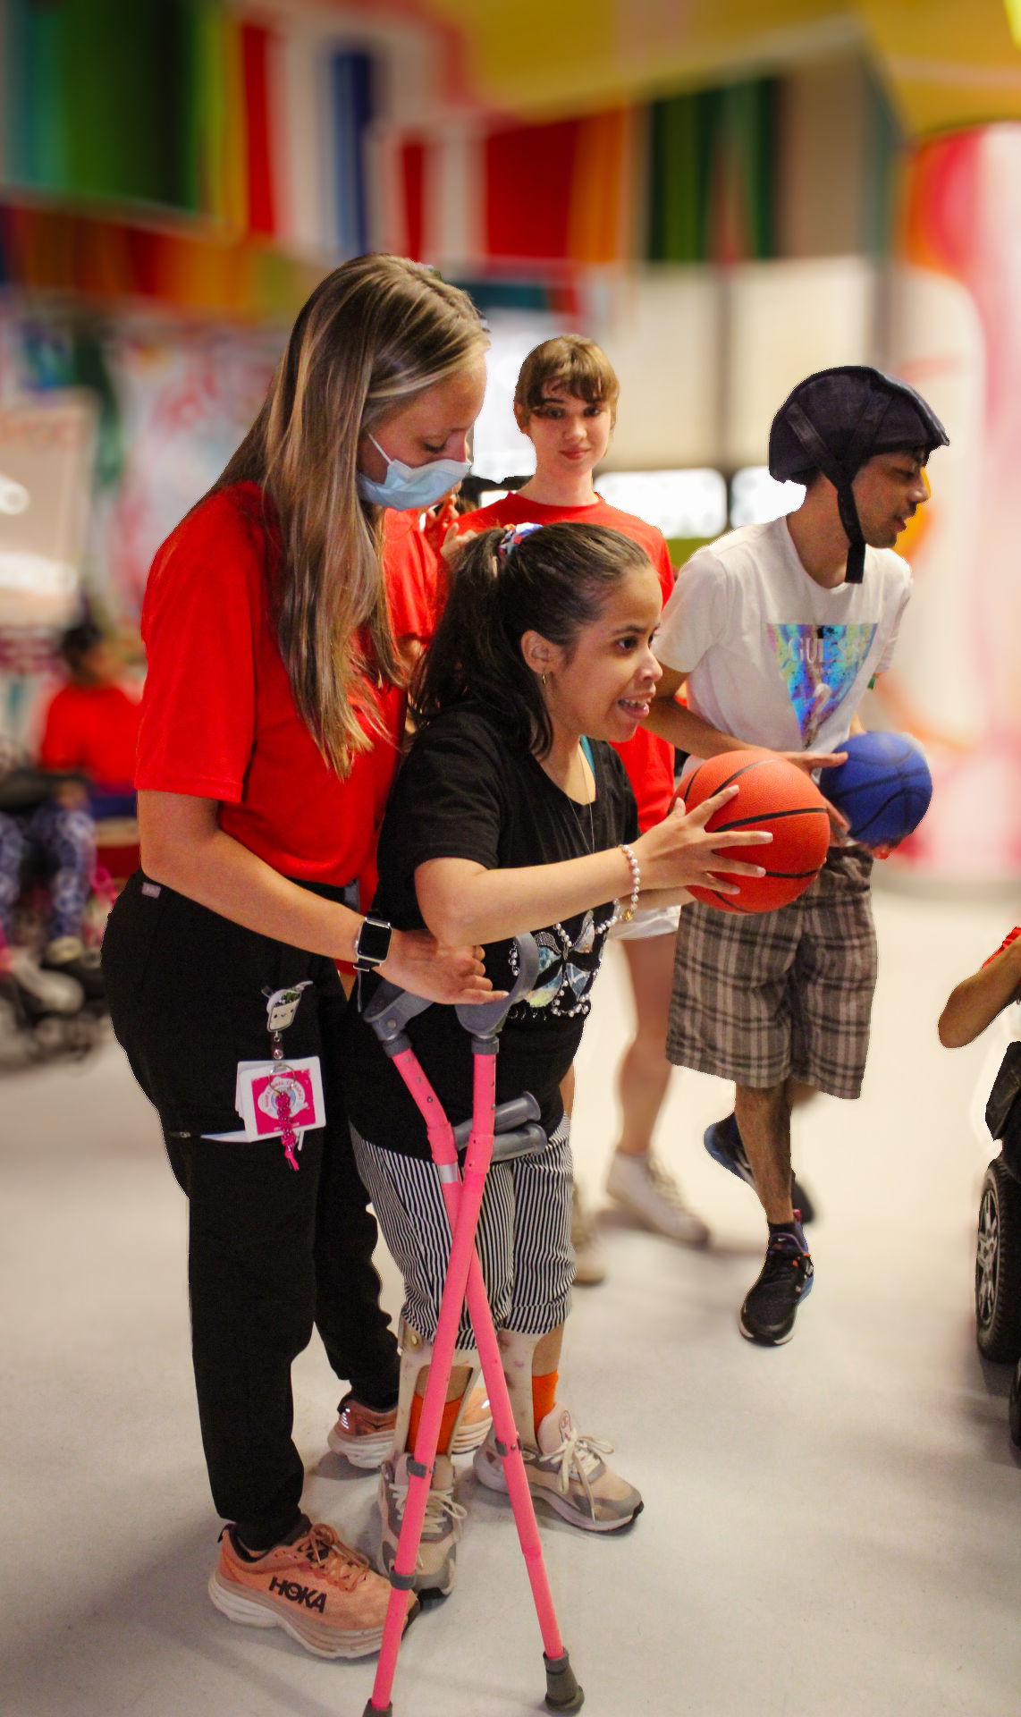
A Comprehensive Bundled Approach to Care
MDHC is a well-balanced, bundled program designed to support each participant’s individualized goals, medical needs, independence, and overall quality of life.
Programs Offered:
Young Adult Program
After-School Program
Weekend Program
Comprehensive Services Included:
Nursing services
Rehabilitative services
Therapeutic recreation
Activities of daily living, or ADL, care
Diabetes management
Weight management
Socialization opportunities
Community integration
Round-trip transportation
Nutritious meals

Slide 5
Why a Medical-Model Afterschool Program Matters
For children with medical complexity, a traditional afterschool program may not have the staffing, clinical oversight, accessibility, or rehabilitative support necessary for safe and meaningful participation.
MDHC integrates nursing, rehabilitation, nutrition, recreation, and social opportunities into the participant’s afternoon. Therapeutic goals can be reinforced during shared meals, group activities, recreation, communication opportunities, self-care routines, and community experiences.
The difference is integration:
Therapy does not end when the formal session ends.
Communication is practiced with peers and staff.
Motor skills are used during play and recreation.
Self-care skills are reinforced during daily routines.
Social skills are practiced in natural group settings.
Participants have opportunities to make choices and advocate for themselves.

Slide 6
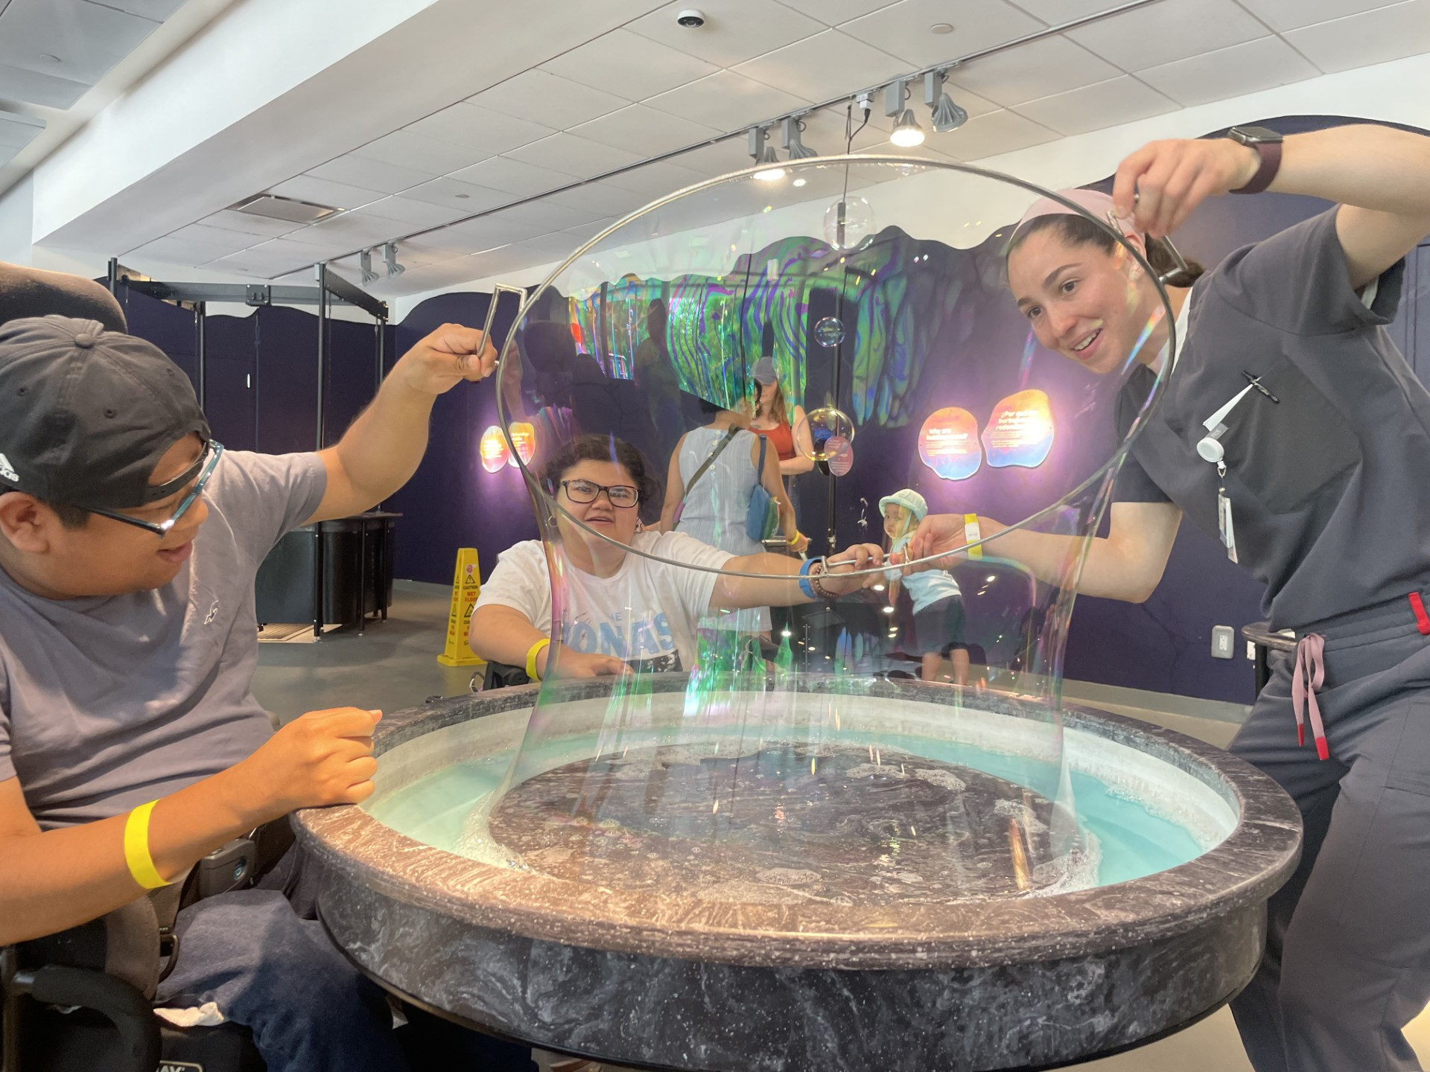
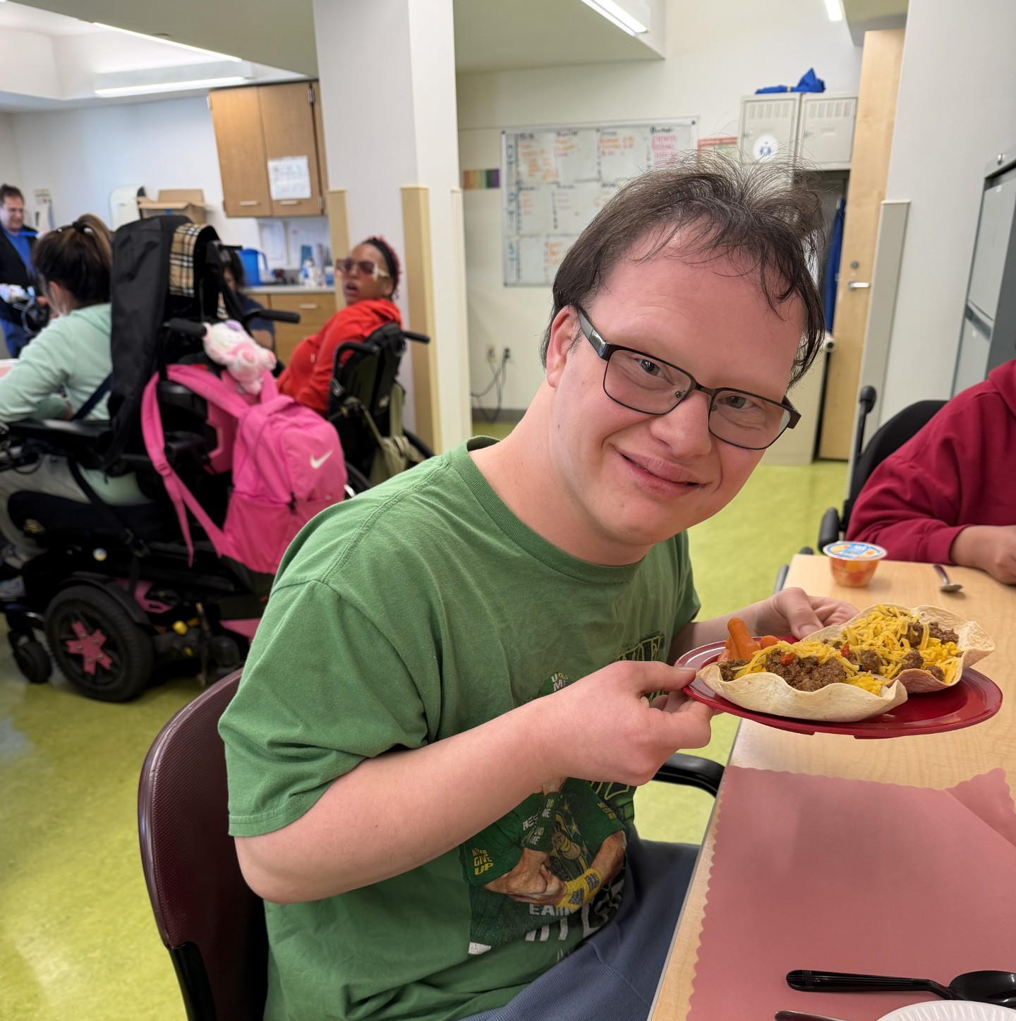
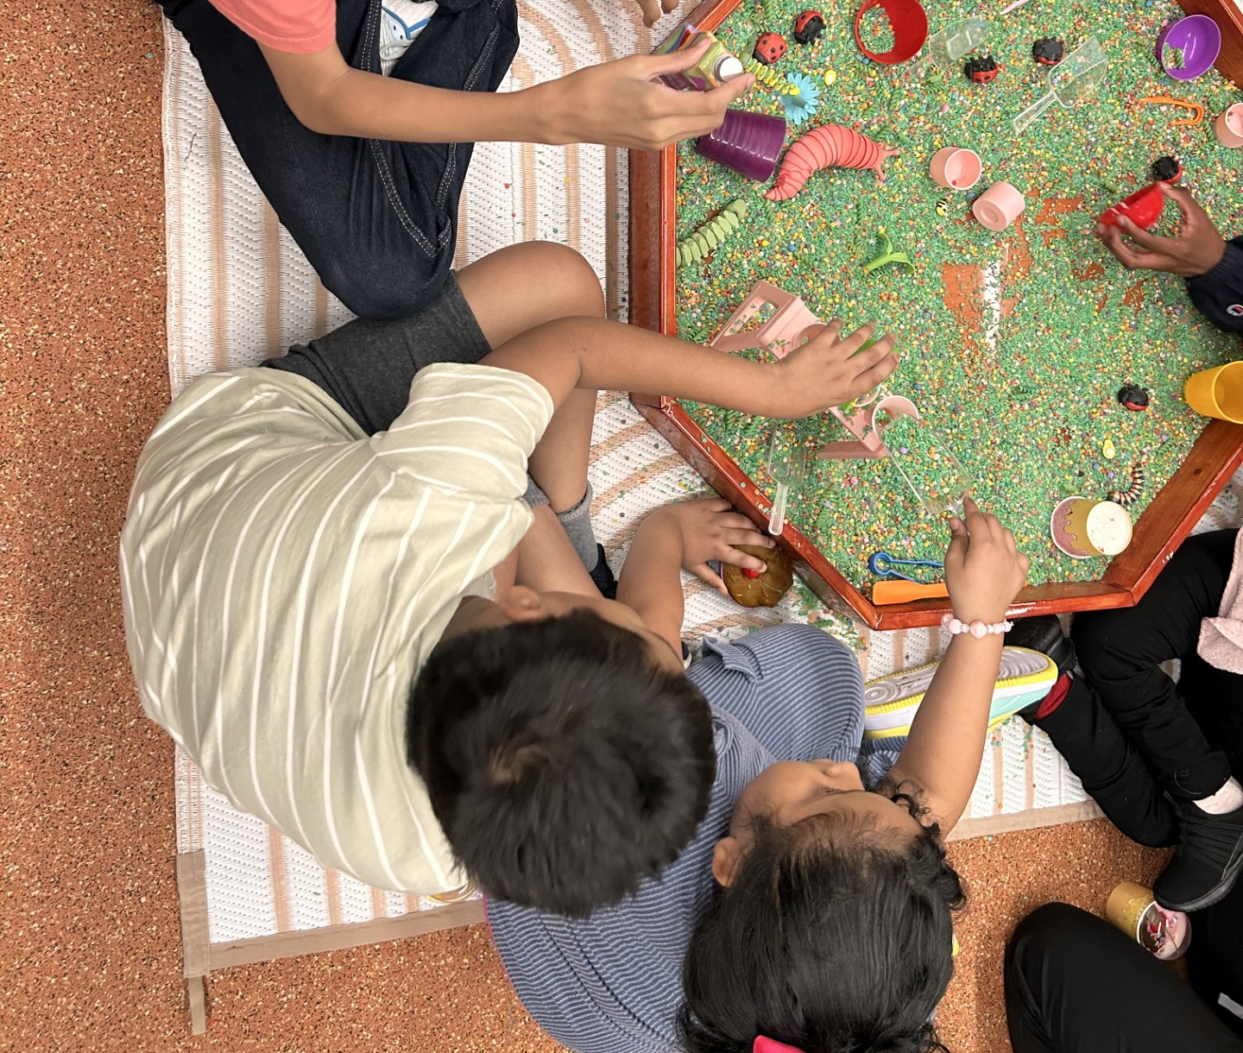
Building Meaningful Days
MDHC creates purposeful programming, participants are provided with opportunities to learn, socialize, build confidence, develop skills, and engage in meaningful experiences that reflect their interests, abilities, and personal goals.
  Adaptive Recreation
  Sensory Experiences
  Cooking and Life Skills Groups
  Health and Wellness
  Vocational Experiences

Slide 7
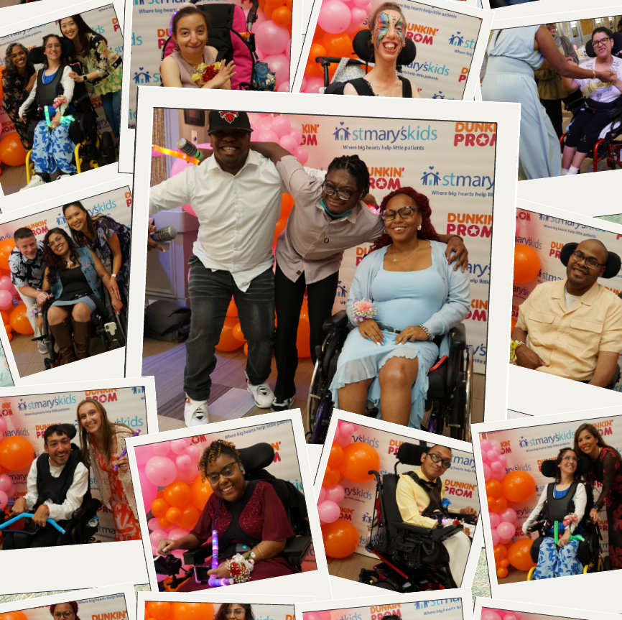
Social Connection and Belonging
At MDHC, social connection and belonging are at the heart of what we do. We strive to create a welcoming, inclusive environment where participants develop meaningful relationships, support one another, and feel valued as members of a community.
How We Build Connections:
Encouraging friendships, teamwork, and peer support
Celebrating holidays, milestones, birthdays, and personal achievements
Hosting prom, Summer Olympics, Family Fun Days, and other special events
Providing inclusive experiences and community outings
Maintaining open communication and family involvement in care planning and goal development

Slide 8
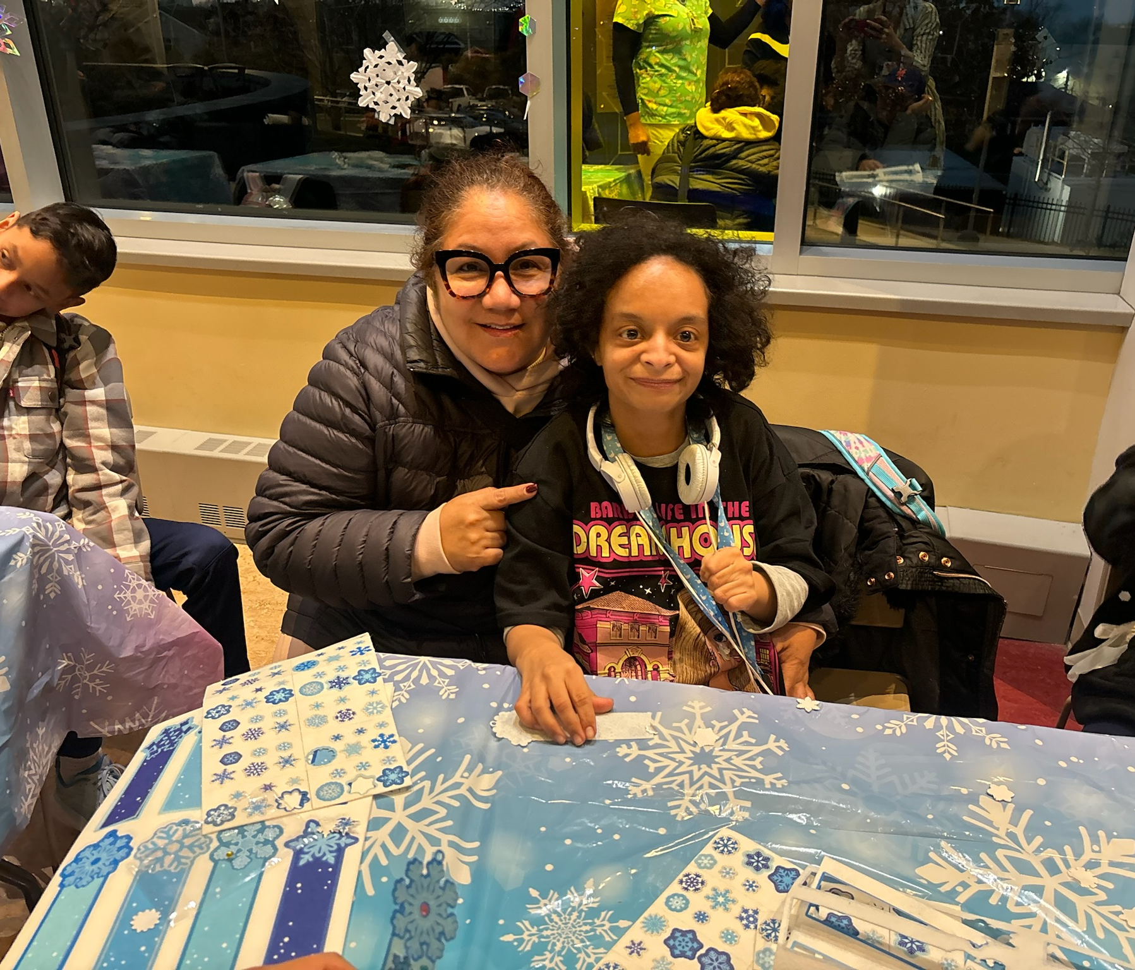
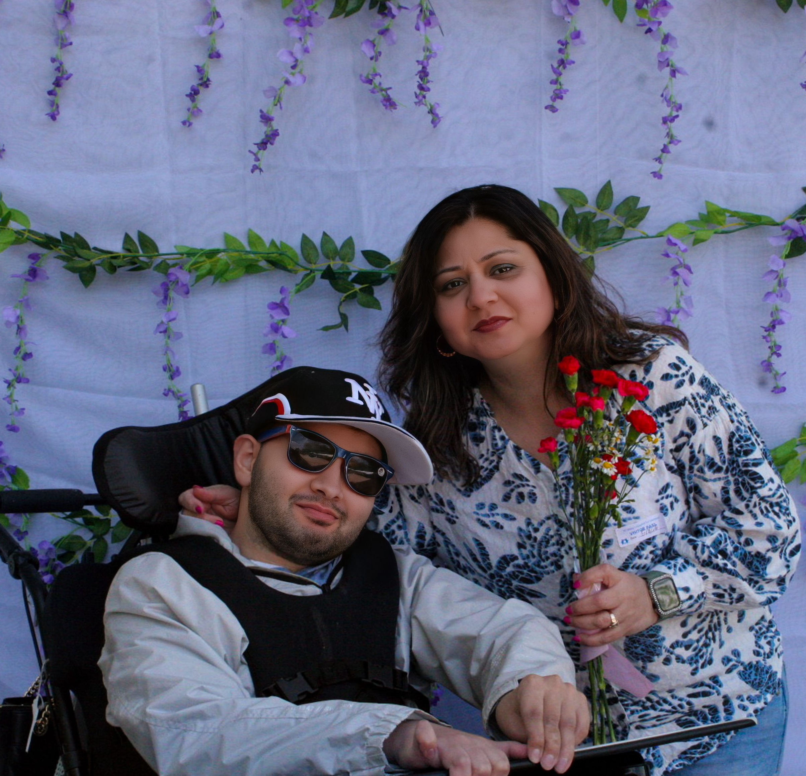
Supporting Families
The MDHC Program at St. Mary's provides families with
A structured and supportive environment for their child
Access to an interdisciplinary team
Opportunities for their child to socialize safely
Reinforcement of functional and therapeutic goals
Transportation support
Family communication and involvement
Parent groups and educational opportunities
Family Fun Days and shared program experiences
Family involvement is included in MDHC’s person-centered care approach, and your existing materials emphasize family communication, care planning, parent groups, and family events

Slide 9
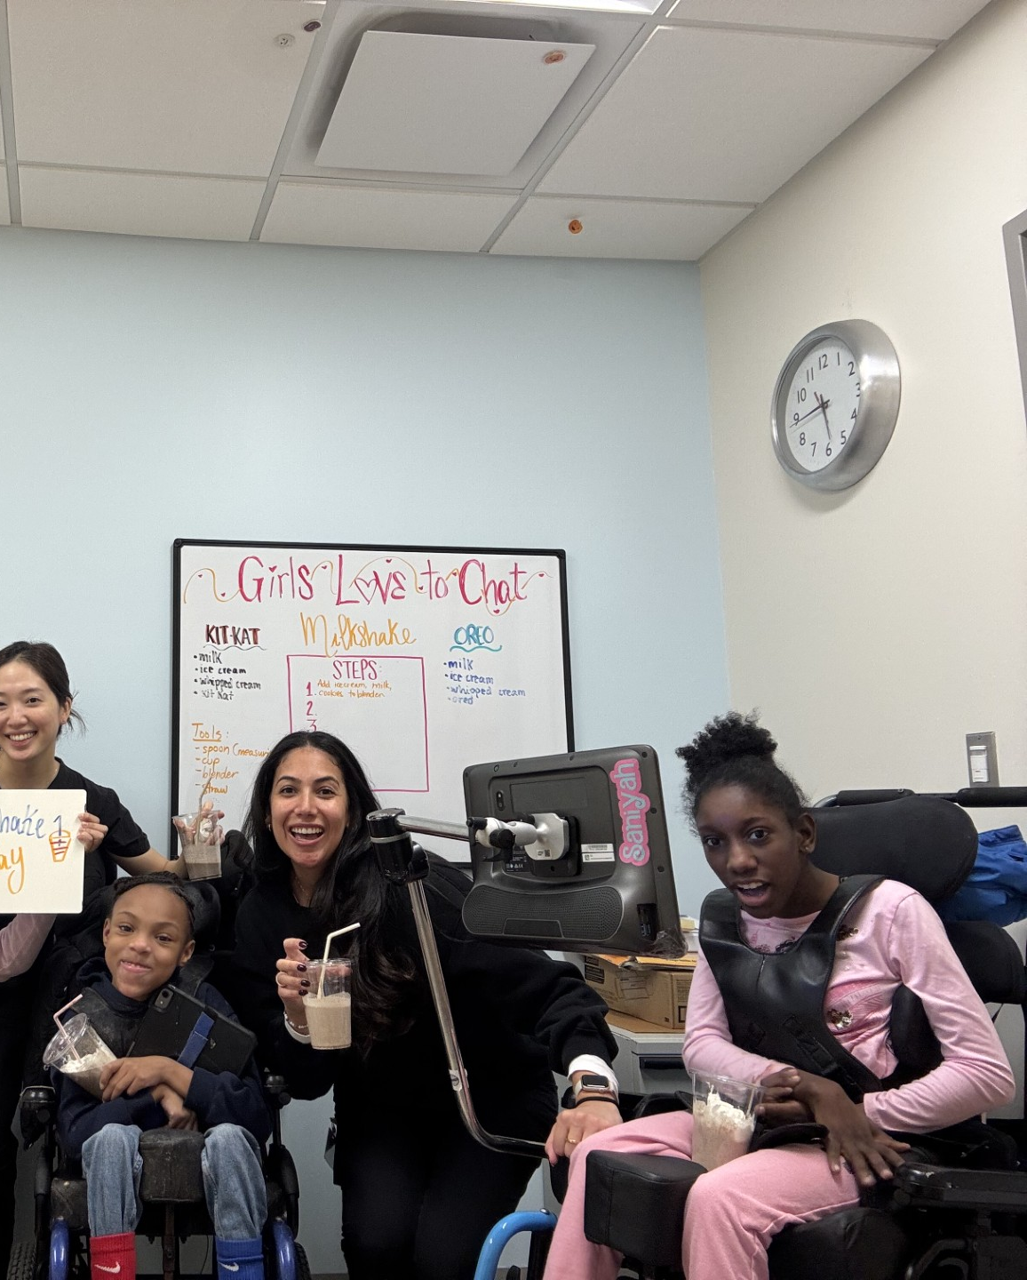
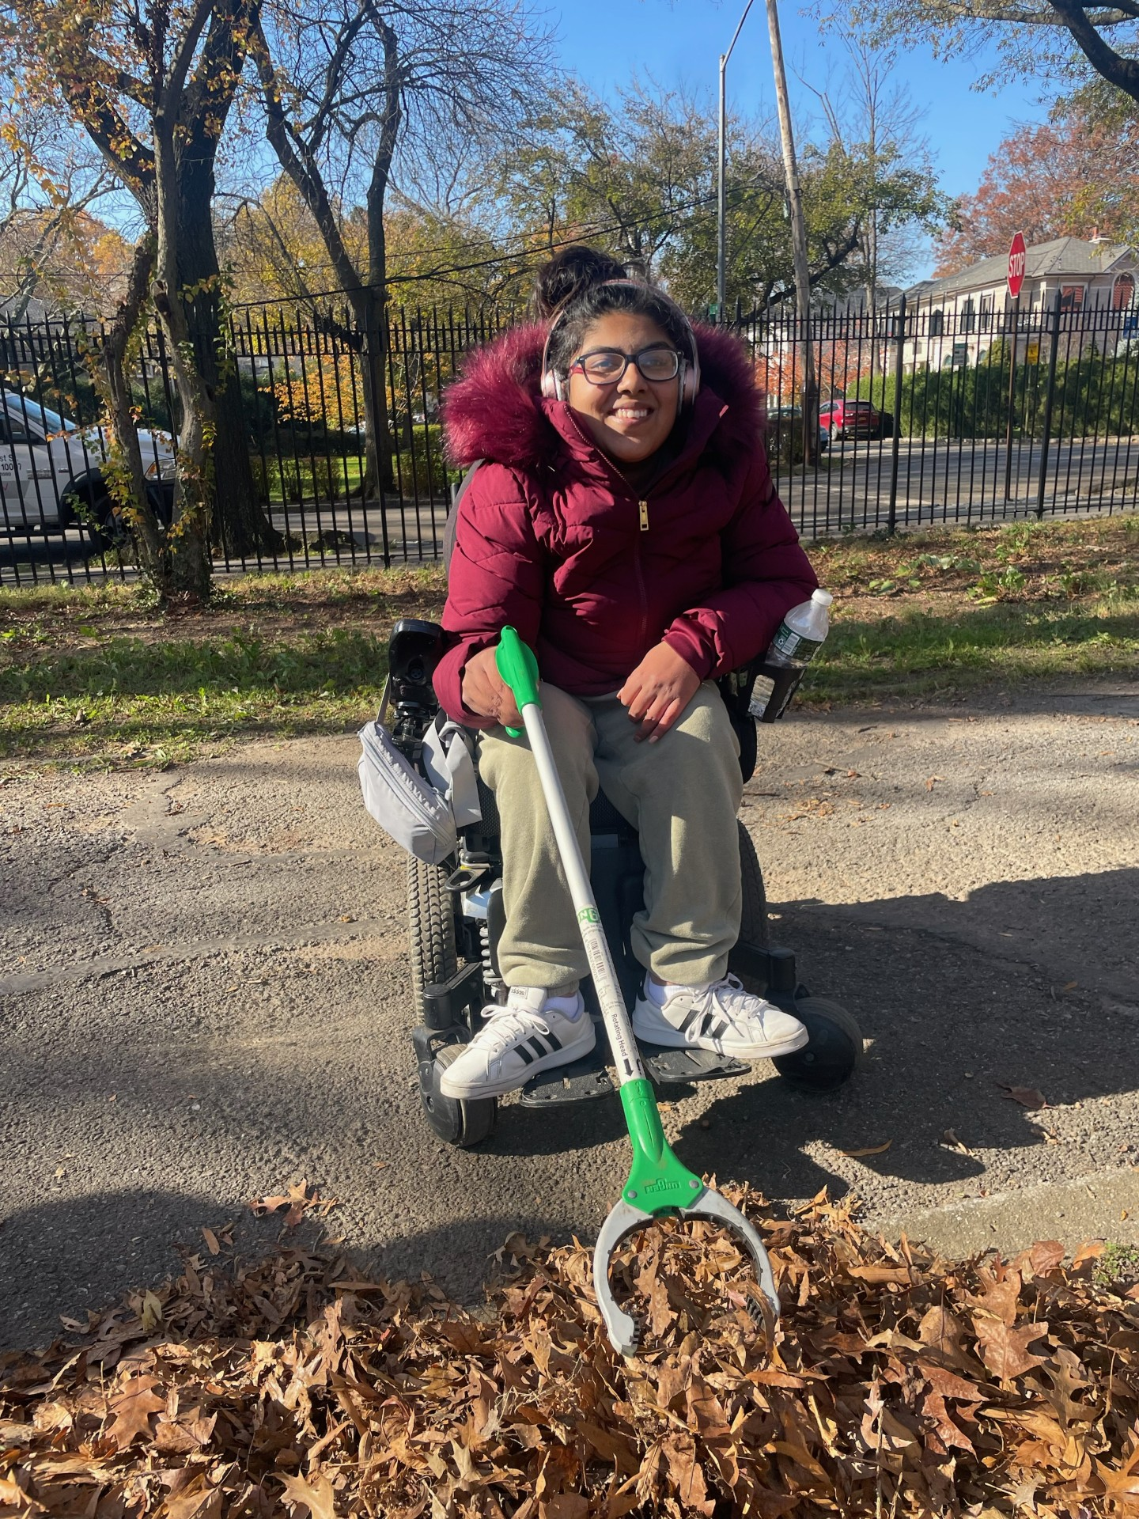
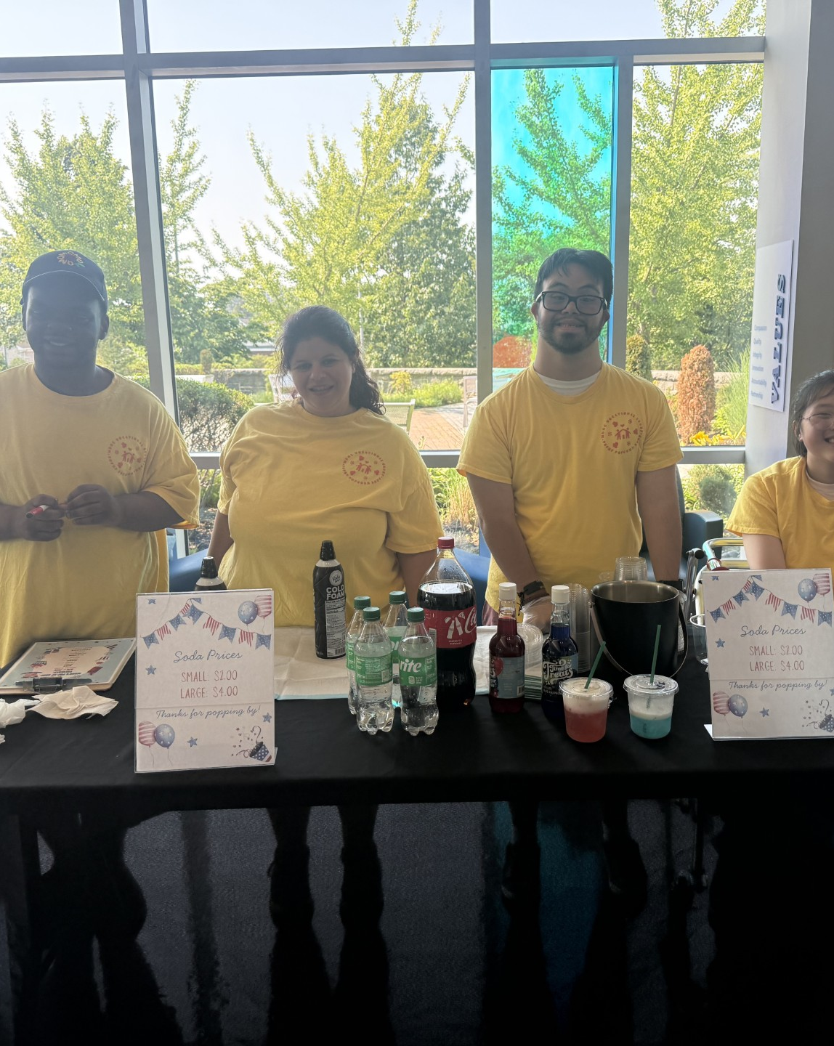
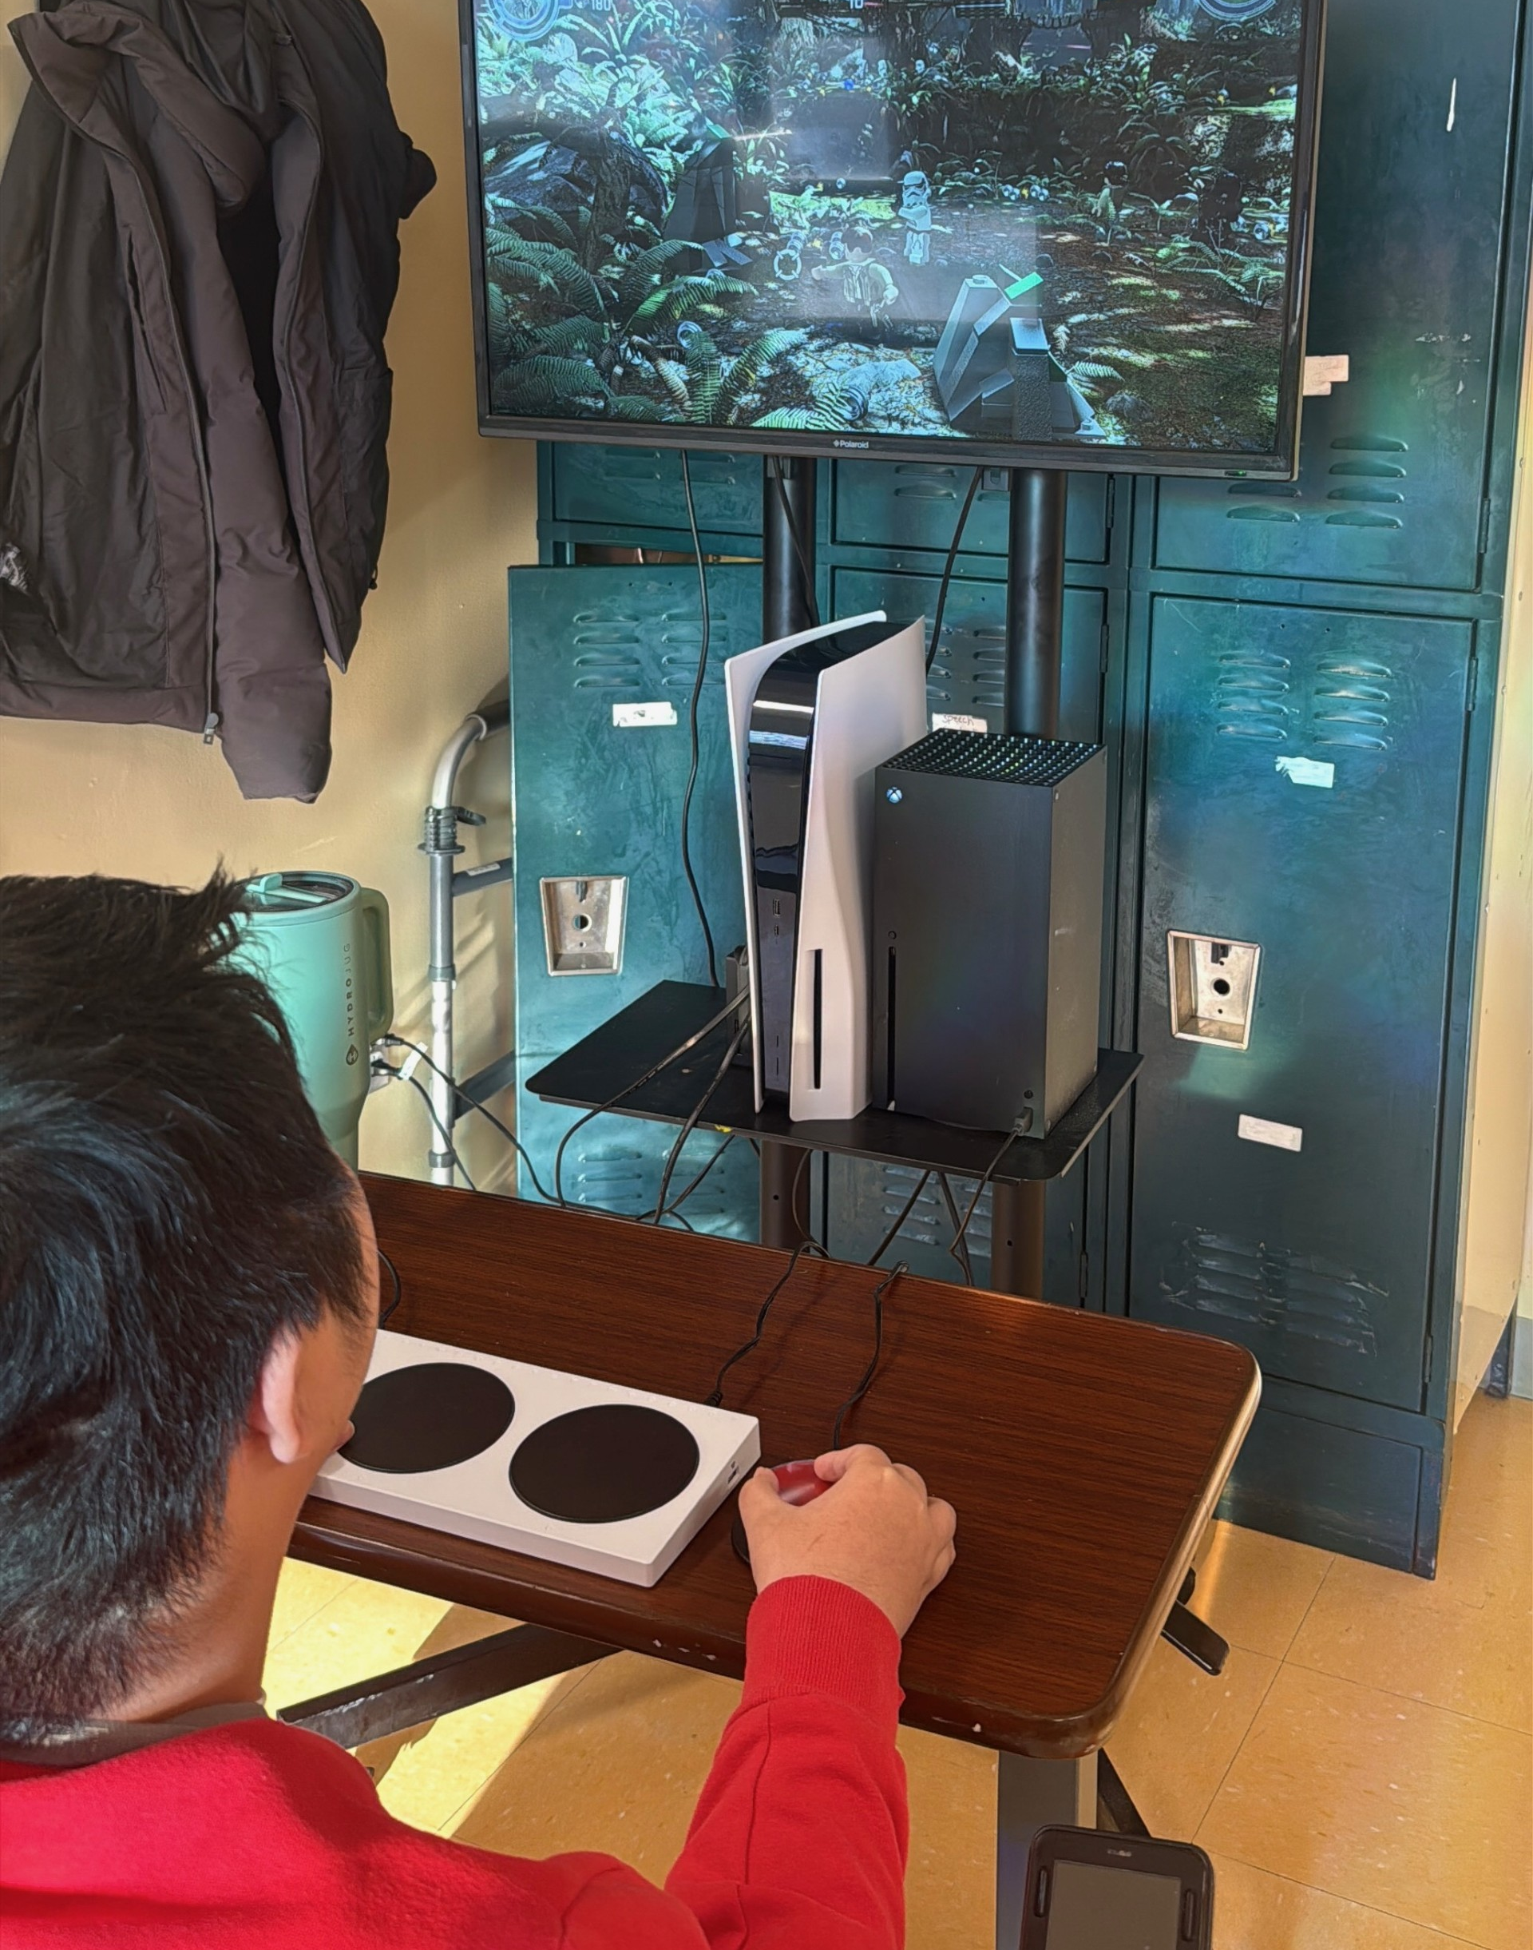
Creating an Inclusive Social Environment
At MDHC, independence looks different for every participant. Through individualized supports, skill-building opportunities, adaptive equipment, and therapeutic interventions, we help participants maximize their abilities, increase self-confidence, and achieve meaningful personal goals.
Communication: Using AAC devices to express choices, advocate for needs, and connect with peers
Vocational Skills: Weekly groups throughout the facility focusing on sequencing, money management, customer relations, teamwork, and task completion
Life Skills: Practicing decision-making, self-care, and everyday responsibilities
Adaptive Technology: Exploring communication, feeding, mobility, and recreational devices that increase independence and participation
Sensory supports
Recognizing engagement in different forms
Participation does not have to look the same for everyone. One participant may lead a conversation, another may make a choice using an AAC device, and another may engage through facial expressions, movement, or sensory exploration. Each form of participation matters.

Slide 10
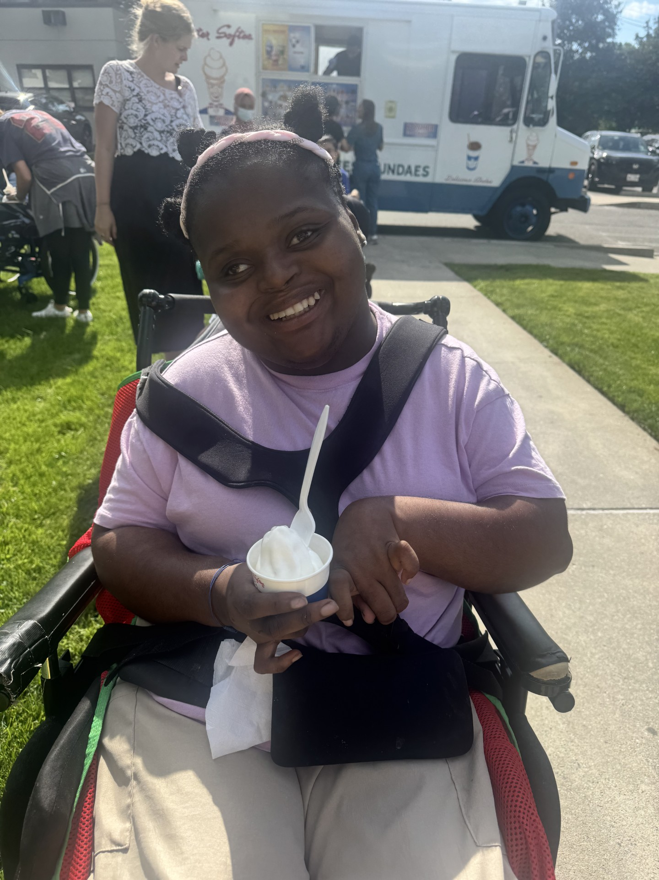
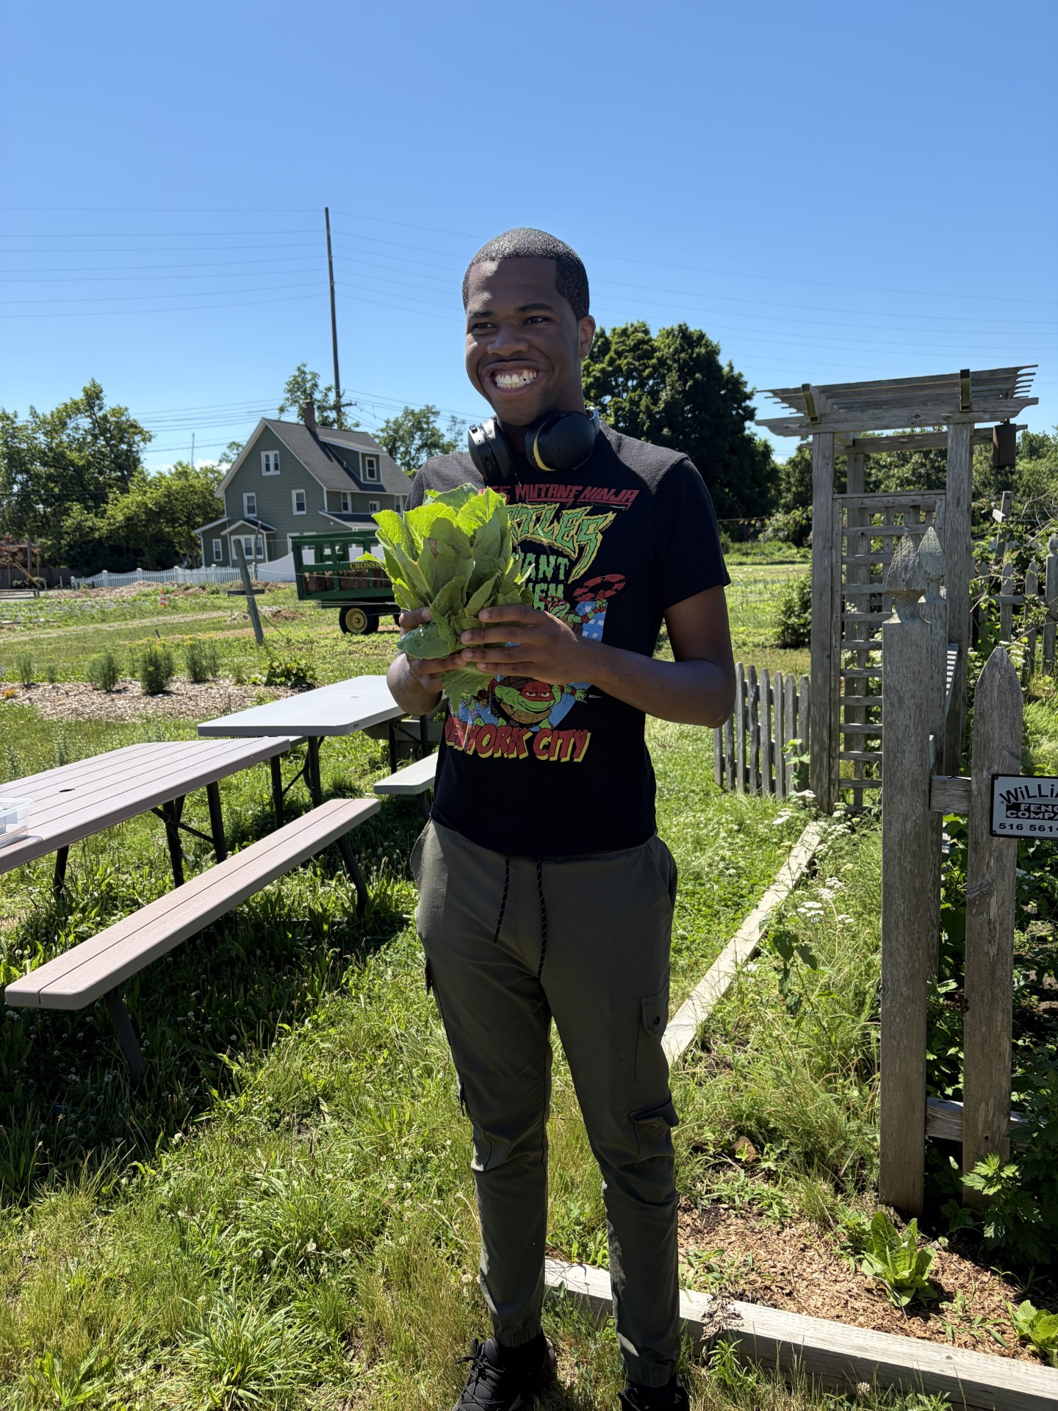
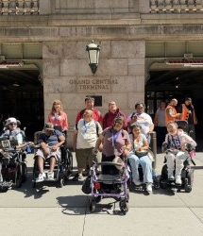
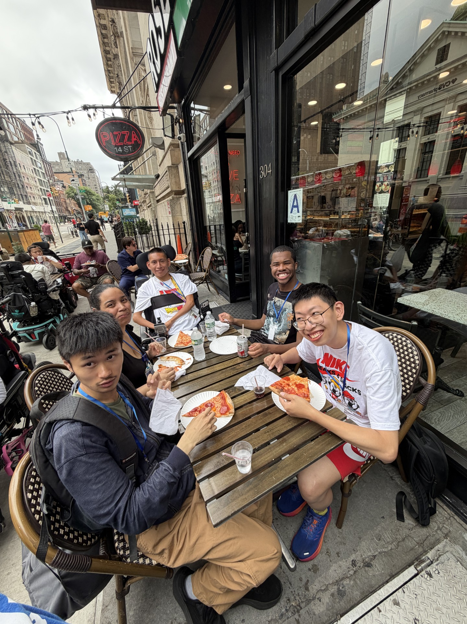
Living Life Beyond Our walls
At MDHC, community integration is an important part of person-centered care and quality of life. Participants enjoy a wide variety of community outings designed around their individual interests, abilities, goals, and support needs.
Community Outings May Include:
Volunteering and participating in community service projects at Crocheron Park
Visiting museums and cultural attractions
Dining at restaurants and cafés
Shopping at local stores
Attending sporting events, shows, and seasonal celebrations
Visiting libraries and community centers
Participating in recreational, educational, and vocational experiences
More Than Just an Outing
Each community experience provides opportunities for participants to:
Practice communication and social skills
Make choices and express personal preferences
Develop independence and self-confidence
Strengthen daily living and money-management skills
Give back through volunteering and community service
Explore new interests and experiences
Build relationships and a sense of belonging

Slide 11
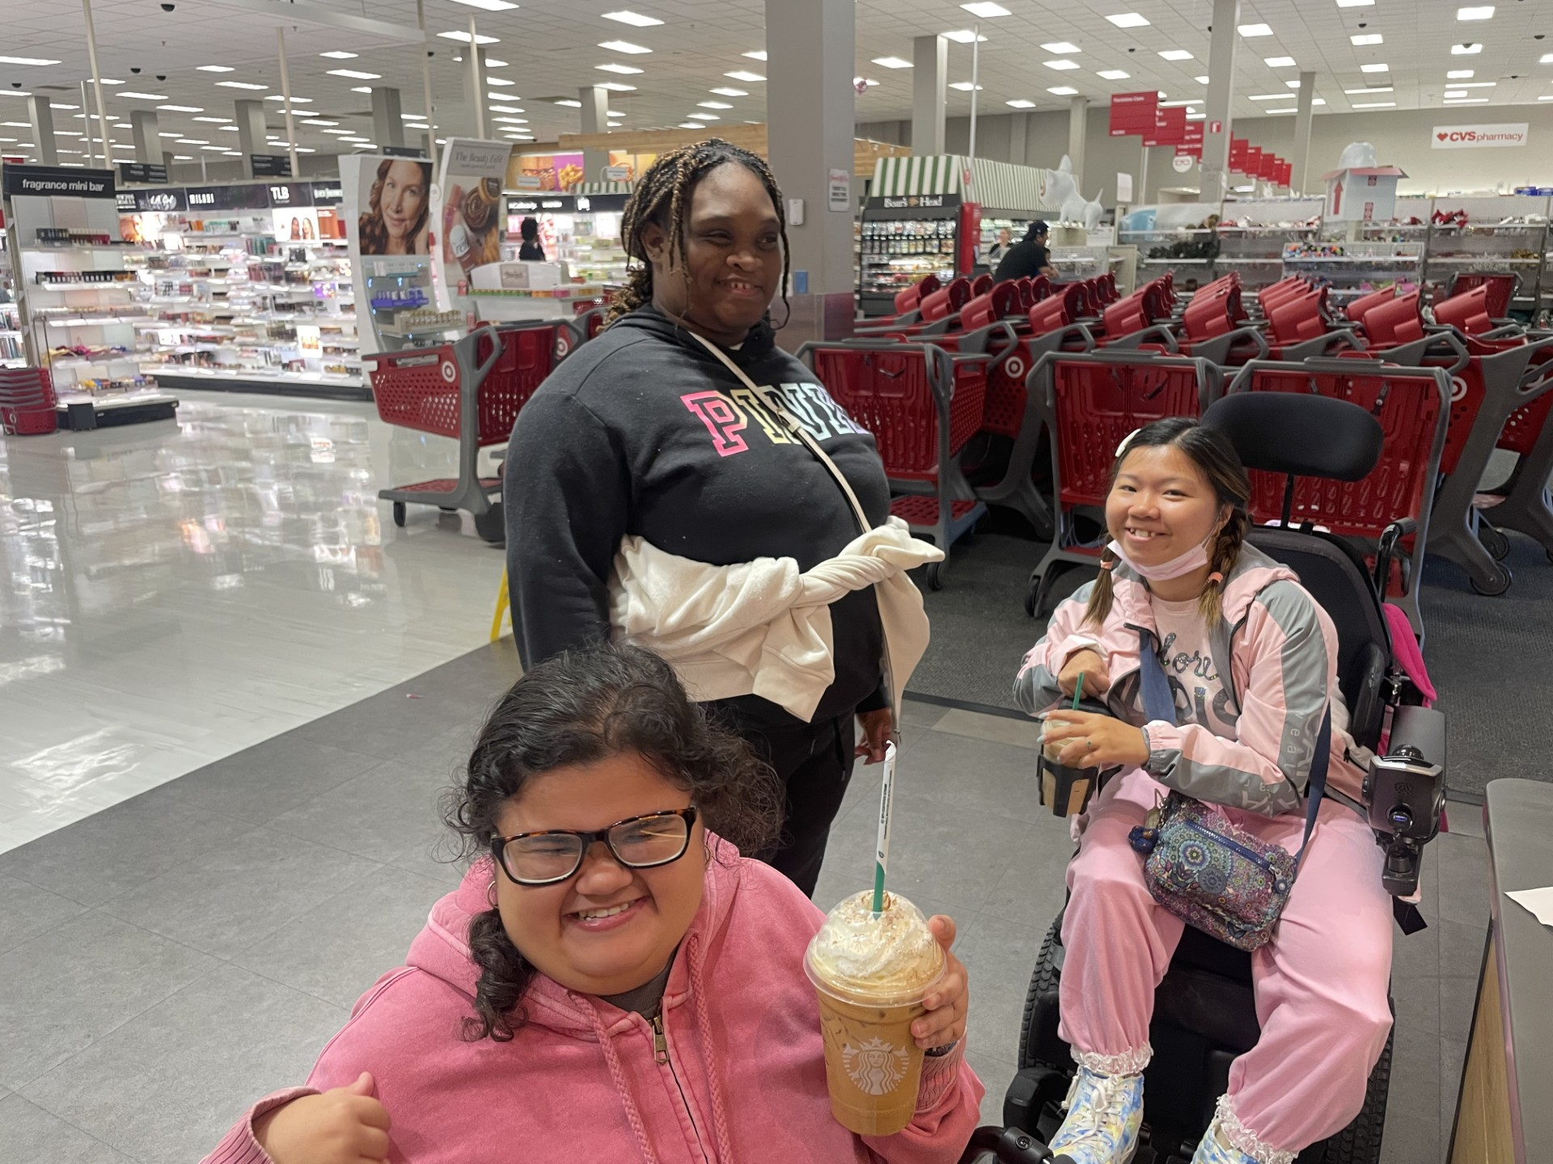
Why Community Integration is Important:
Community experiences create opportunities for participants to practice:
Communicating with unfamiliar people
Making purchases
Handling money
Ordering food
Making choices
Navigating public spaces
Following safety expectations
Waiting in lines
Managing sensory demands
Traveling with a group
Advocating for assistance
Developing confidence in unfamiliar environments
Community outings also help reduce isolation and ensure that children and young adults with medical complexity are visible, included, and welcomed within their communities.

Slide 12
From the Activity Room To the Community
A skill may begin in therapy or in the activity room, but it becomes more meaningful when it can be used in daily life.
Examples:
Practicing communication in speech therapy, then ordering food during an outing
Working on dressing skills in occupational therapy, then preparing for a community trip
Practicing mobility in physical therapy, then navigating a store or park
Learning turn-taking during a game, then waiting appropriately in a community setting
Practicing money skills in a vocational group, then making a purchase
Learning kitchen safety in a cooking group, then helping prepare food at home
Practicing AAC use in a structured group, then communicating choices with peers and community members

Slide 13
Fun with Purpose
Afterschool activities should be enjoyable, age-appropriate and connected to the participants' interests & needs.
Participants with Higher Support Needs May
Benefit From:
Sensory-based activities
Music and movement
Adaptive technology and switch-access activities
Interactive storytelling
Cause-and-effect games
Adapted arts and crafts
Small group social experiences
Multisensory exploration
Therapeutic recreation with increased staff support
RN Oversight
Assistance with all ADL's
Participants with Moderate Support Needs May Benefit From:
Group games and recreation
Cooking and life skills activities
Adaptive sports and fitness
Community outings
Social groups
Fitness classes
Creative arts programs
Functional communication opportunities
Participants Seeking Greater Independence May Benefit From:
Vocational and pre-vocational opportunities
Volunteer experiences
Community-based instruction
Leadership opportunities
Money management activities
Travel training concepts
Community recreation programs
Self-advocacy groups
The Goal
Activities should be:
✅ Age-appropriate
✅ Accessible
✅ Person-centered
✅ Adaptable
✅ Meaningful
✅ Focused on individual goals

Slide 14
Choosing the Right Program
Finding the right program is about more than availability. Families should look for a program that promotes safety, growth, independence, socialization, and meaningful participation.
Safety & Staff Support
Are staff trained to support my child's unique needs?
Is nursing or medical oversight available if needed?
What is the staff-to-participant ratio?
How are emergencies, behavioral challenges, and medical concerns managed?
Opportunities for Socialization
Does the program encourage friendships and peer interaction?
Are activities designed to promote communication and participation?
Will my child have opportunities to be included and feel a sense of belonging?
Community Integration
Does the program provide opportunities to access the community?
Are outings meaningful, accessible, and age-appropriate?
Does the program help participants practice real-life skills in community settings?
Individualized & Person-Centered Programming
Are activities adapted to meet different abilities and interests?
Is my child encouraged to make choices and pursue personal goals?
Are communication supports available when needed?
Meaningful Activities
Look for programs that offer:
Recreation and leisure activities
Fitness and movement opportunities
Creative arts and music
Life skills development
Vocational or pre-vocational experiences
Community partnerships and special events
Family Communication
How often will I receive updates?
Am I involved in planning and goal setting?
Does the program view families as partners?

Slide 15
Building a Life Beyond School
Dancing Dreams (Bayside & Plainview)
Adaptive dance classes for children and young adults with physical and medical challenges
Ballet, tap, jazz, and hip-hop
Performance opportunities and peer mentorship program
HorseAbility (Old Westbury)
Therapeutic horseback riding and equine-assisted activities
Promotes confidence, communication, balance, and social interaction
Opportunities for recreation and community involvement
Adaptive Fitness Programs:
Inclusive fitness
opportunities designed for varying ability levels
Group exercise, movement, strength-building, and wellness activities
Can be brought into community programs or attended through community recreation providers
YMCA
Adaptive swim lessons
Inclusive recreational opportunities
Water-based fitness and social groups
Nassau County Aquatic Center
Offers adaptive aquatics and community recreation opportunities throughout the year.
American Pool Adaptive Swim Programs
Several Long Island locations offer individualized and adaptive swim instruction.
Queens Botaniccal Gardens:
Sensory Friendly and accessible programming for children and families
Local Library Programs
JCC Programs
Inclusive recreational programs
Fitness classes
Social Groups
Adaptive Sports & Recreation
Special Olympics New York
Basketball
Bowling
Swimming
Track & field
Soccer
Tennis
Unified sports opportunities
Special Olympics is often one of the best ways for participants to build friendships while increasing physical activity and confidence.
Achilles International Kids Program
Provides adaptive running and recreational opportunities for children with disabilities.
ASA Hoops (Long Island)
Adaptive basketball programming that promotes teamwork, fitness, and social engagement.
American Softball

Slide 16
More Than a Program
Families are not simply looking for a place to go after school
They are looking for:
❤️ Friendships
🌟 Meaningful experiences
🎯 Opportunities to learn and grow
🤝 A sense of belonging
🏃 Opportunities to be active and engaged
🎨 Ways to discover interests and talents
🌎 Connections within their community
🗣️ A voice and opportunities to make choices
Children and young adults with disabilities deserve more than care.
They deserve opportunities to build friendships, explore interests, participate in their communities, and experience the same joy, purpose, and connection as their peers.
When we focus on socialization, inclusion, community integration, and person-centered support, we create opportunities that extend far beyond the program day and help build a meaningful quality of life.

Slide 17
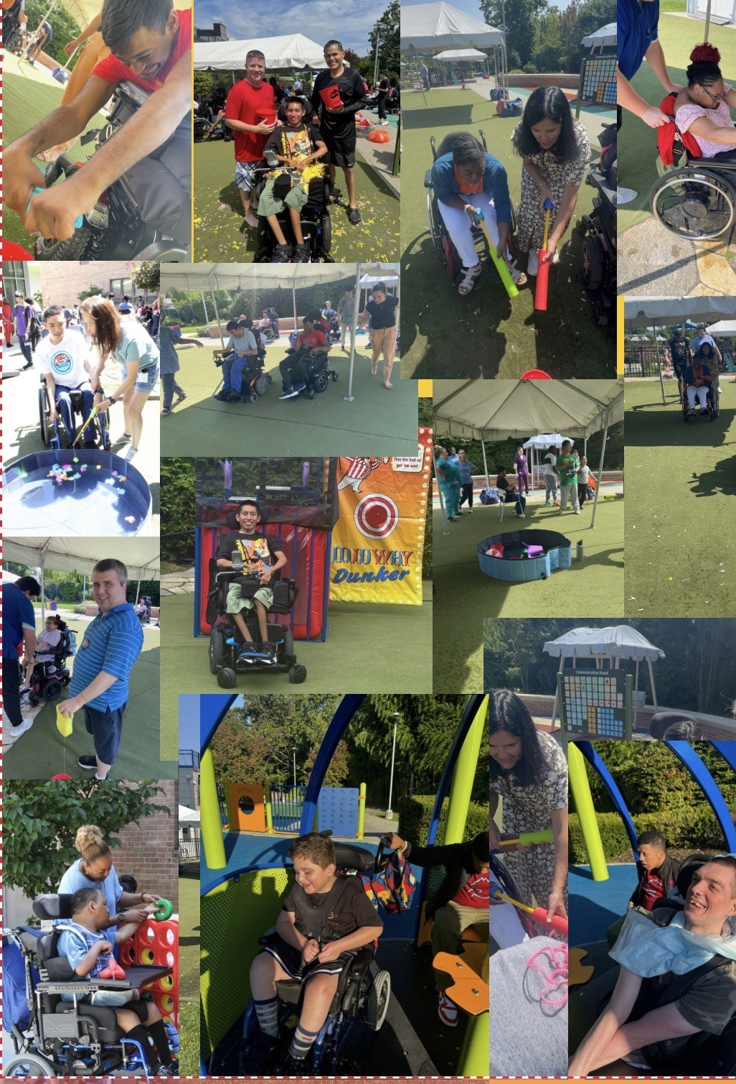
Thank You
Questions & Discussion

Slide 18

Jillian Quinn
718-281-8508
 JQuinn@stmaryskids.org
www.stmaryskids.org

