Slide 1
Supporting Educators and
Parents on a Path of Success
Special Education Roadmap
Notes:
[Sources]
Content summarized from IEP Roadmap PDF.

Slide 2
The Individuals with Disabilities Education Act (IDEA): is a law that makes available a free appropriate public education to eligible children with disabilities throughout the nation and ensures special education and related services to those children.
The IDEA governs how states and public agencies provide early intervention, special education, and related services to millions of eligible infants, toddlers, children, and youth with disabilities.

Slide 3
IDEA Foundations
• FAPE: Every child with a disability has the right to a free appropriate public education that meets their unique needs.
FAPE 22: Students with disabilities can keep receiving special education services through age 21 (up until their 22nd birthday).
• LRE (Least Restrictive Environment): Children with disabilities should learn alongside classmates without disabilities as much as possible.
• Procedural Safeguards: IDEA protects the rights of students and families by ensuring that parents can be involved in decision-making, they can appeal decisions they disagree with and access necessary resources at any time.
• Related Services: like speech therapy, physical therapy, occupational therapy or counseling, that supports a child so they can learn and grow at school.
Notes:
[Sources]
Content summarized from IEP Roadmap PDF.

Slide 4
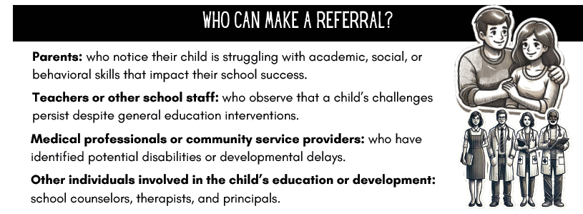
Referral Process
Notes:
[Sources]
Content summarized from IEP Roadmap PDF.

Slide 5
Referral Process cont.
Submit a written request
Include supporting information
Consent for evaluation
Once a referral is made, schools must adhere to specific timelines that are set by IDEA:
- Within 15 days of the referral, the school must provide parents with a formal response, either agreeing to proceed with the evaluation or denying the request, with a clear explanation.
- Within 60 days, once parental consent is obtained, the school has to complete the initial evaluation and determine eligibility for special education services.

Slide 6
Evaluation
& Eligibility
• Purpose of Evaluation
• Parental Consent and Rights
• Areas of Assessment
• Assessment Tools
• Eligibility
Notes:
[Sources]
Content summarized from IEP Roadmap PDF.

Slide 7
Identify if a child has a disability that impacts their educational performance.
Understand the child’s specific strengths, challenges and areas of need.
Provide a foundation for developing an effective IEP that outlines targeted goals, accommodations and services.
Purpose of Evaluation
Understand the child’s specific strengths, challenges and areas of need

Slide 8
Parents have the right to:
REVIEW – the purpose of each assessment
RECEIVE – copies of the evaluation results
REQUEST – independent evaluations if you disagree with the findings
HAVING KNOWLEDGE OF YOUR RIGHTS ensures transparency and empowers you to make informed decisions about your child’s education.
Parental Consent
& Rights
Understand the child’s specific strengths, challenges and areas of need

Slide 9
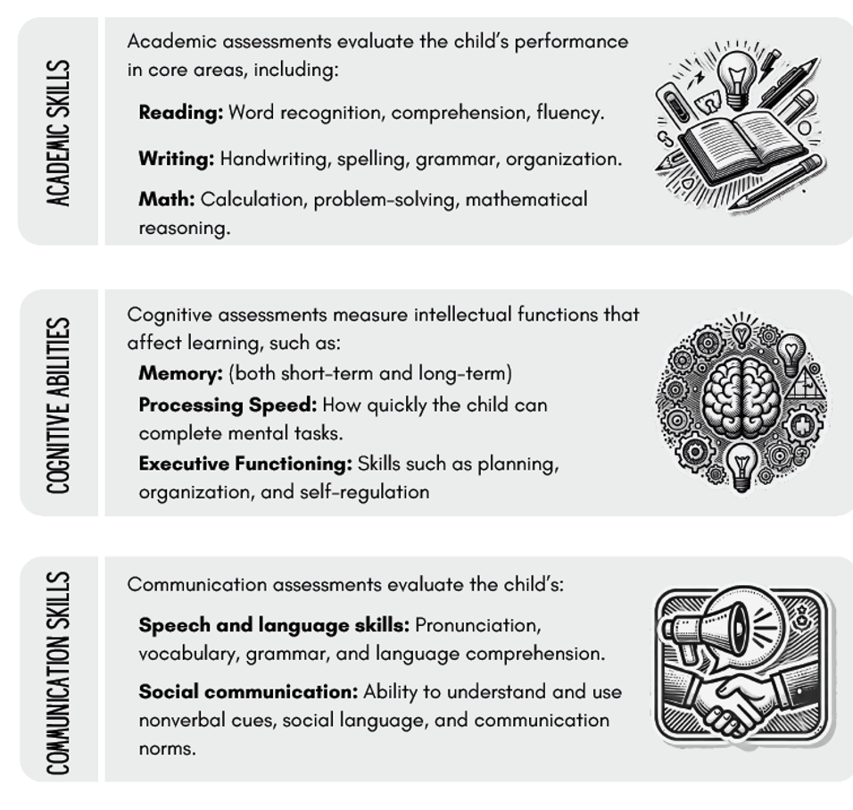
Areas of Assessment

Slide 10
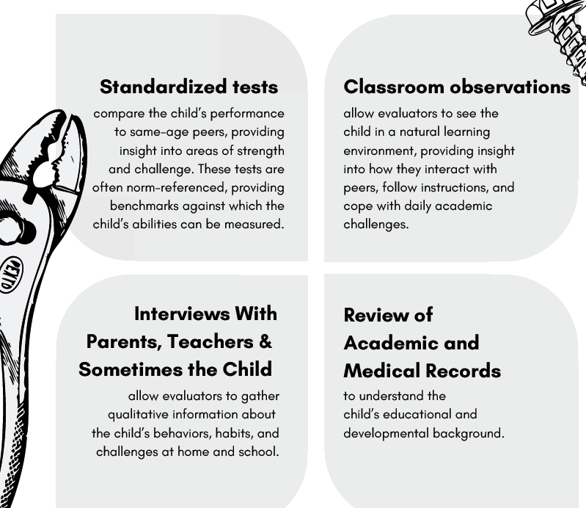
Tools of Assessment

Slide 11
Understanding
Eligibility
The criterion for special education is based on the federal law Individuals with Disabilities Education Act (IDEA). IDEA sets federal guidelines to ensure students with disabilities receive a universal basic level of service and protection at school.
These guidelines are used by the IEP team, Individualized Education Program team. This team includes various school professionals, like teachers, special education experts, and the student’s parents or legal guardians.

Slide 12
Understanding
Eligibility
Educational Eligibility means; that the student has a disability that significantly impacts their ability to learn and benefit from their education. For an individual to receive special education services, their condition needs to directly affect their ability to access classroom curriculum and instruction.
If a child is found eligible:
At the preschool level (CPSE), a child will fall under the “Preschooler with a Disability” category.
At the school age level and beyond (CSE), eligibility requires an individual to meet the criteria outlined in one or more of the 13 disability categories listed in IDEA.

Slide 13
IEP Process
Referral & Evaluation
IEP Meeting
Implementation
Ongoing Review
Notes:
[Sources]
Content summarized from IEP Roadmap PDF.

Slide 14

Key IEP Components
New York State (NYS) regulations defines an IEP as a written, legal document for a student with a disability that is developed, reviewed and revised by a Committee on Special Education, Subcommittee on Special Education or Committee on Preschool Special Education.
The Individualized Education Program (IEP) is the cornerstone of the special education process for each individual student with a disability.
Through an IEP, educators, parents and other professionals collaborate to create a customized plan that supports the student’s academic, behavioral and emotional development.
Notes:
[Sources]
Content summarized from IEP Roadmap PDF.

Slide 15
• Evaluation Results / Testing Results
• Present Levels of Performance
• Annual Goals
• Services & Supports (PT, SLP, OT)
• Accommodations/Modifications
• Progress Monitoring
Services under FAPE
Transportation
Medical Support
LRE in addition to Core (SLP, OT, PT.):
Hearing Education and Hearing Assistive Tech (HAT)
Vision Education
Assistive Technology
Parent Counseling and Training
School Placement Options under FAPE
Notes:
[Sources]
Content summarized from IEP Roadmap PDF.

Slide 16
• Progress reports
• Data logs
• Work samples
• Communication
• Request Changes
Monitoring Progress
Notes:
[Sources]
Content summarized from IEP Roadmap PDF.

Slide 17
Key Takeaways
Special education is a right protected under IDEA, ensuring eligible students receive a Free Appropriate Public Education (FAPE).
Parents are essential members of the IEP team and play a critical role in decision-making throughout the process.
Understanding the referral, evaluation, eligibility, and IEP development process helps families advocate effectively for their children.
Evaluations identify a child's strengths, needs, and supports required for educational success.
The IEP is a living document that outlines individualized goals, services, accommodations, and progress monitoring.
Students should receive services in the Least Restrictive Environment (LRE), promoting inclusion whenever appropriate.
Regular communication and progress monitoring ensure that services remain effective and responsive to student needs.
Collaboration between educators, service providers, and families leads to the best outcomes for students.
Every child has unique strengths and deserves individualized support to reach their fullest potential.
Families should know their rights, procedural safeguards, and available resources to make informed decisions.
Resources:
Leech, J., Dennison, M., & Mott, M. (2025). The IEP roadmap: Supporting educators and parents on a path of success. AdaptEd 4 Special Ed.
Wright, P. W. D., & Wright, P. D. (2023). Wrightslaw: Special education law (3rd ed.). Harbor House Law Press.
Notes:
[Sources]
Content summarized from IEP Roadmap PDF.

Slide 18
"Sometimes real superheroes live in the hearts of small children fighting big battles." — Anonymous

Slide 19
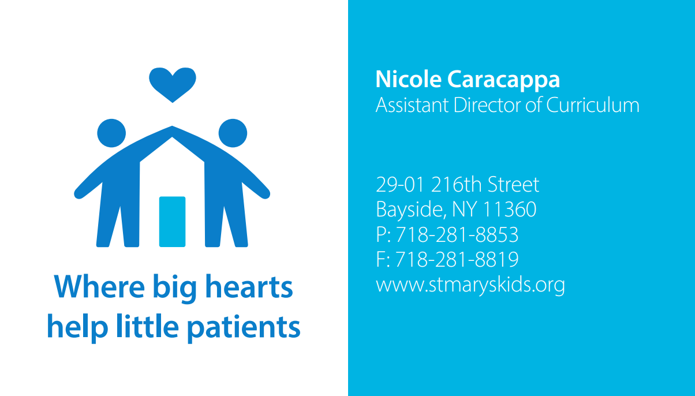
nmege@stmaryskids.org

